Slide 1
Data analysis on Indian railways
Data science AND INTRODUCTION TO PYTHON
Subject code :- CS244

Slide 2
What is covered?
Data collection
Data Preprocessing and cleaning
Data visualization
Data statistics
Hypothesis testing

Slide 3
Data collection

Slide 4
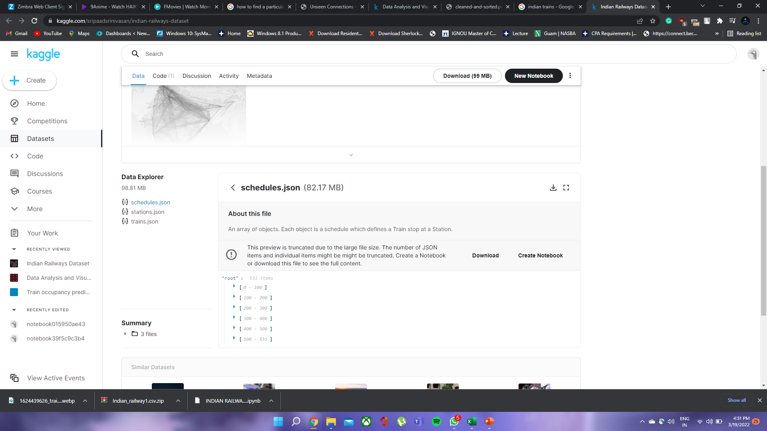
We have taken the data on Indian railways for our project from the following link-
https://www.kaggle.com/sripaadsrinivasan/indian-railways-dataset
There were three datasets namely “schedules”, “stations”, “trains”. In the next step we have cleaned the data.

Slide 5
Data Preprocessing and cleaning

Slide 6
In this, we have processed the data and removed the unnecessary data.
The data was also sorted and made into a more workable and readable format.

Slide 7
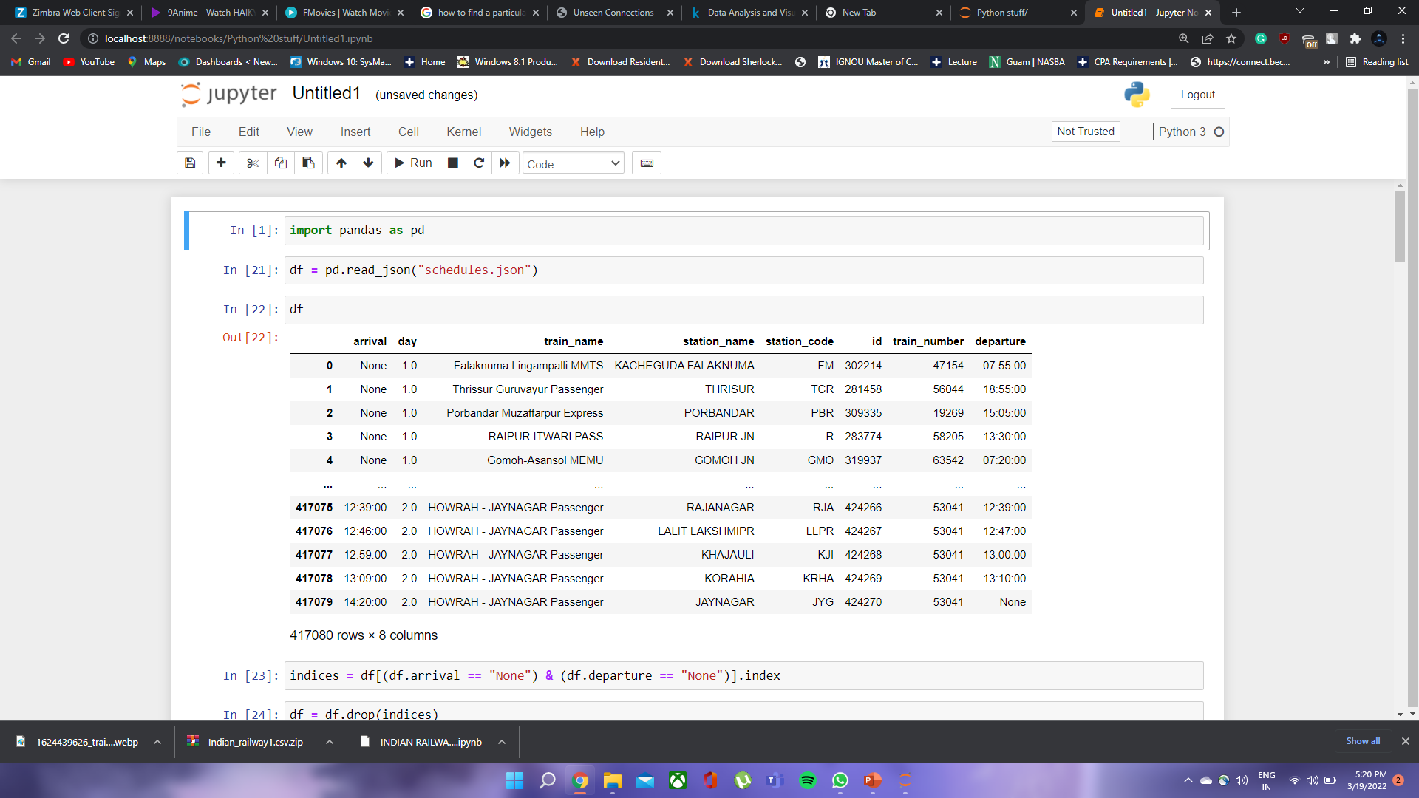
DATA CLEANING OF “SCHEDULES” DATAFILE :-
Opening the datafile using pandas in jupyter notebook.

Slide 8
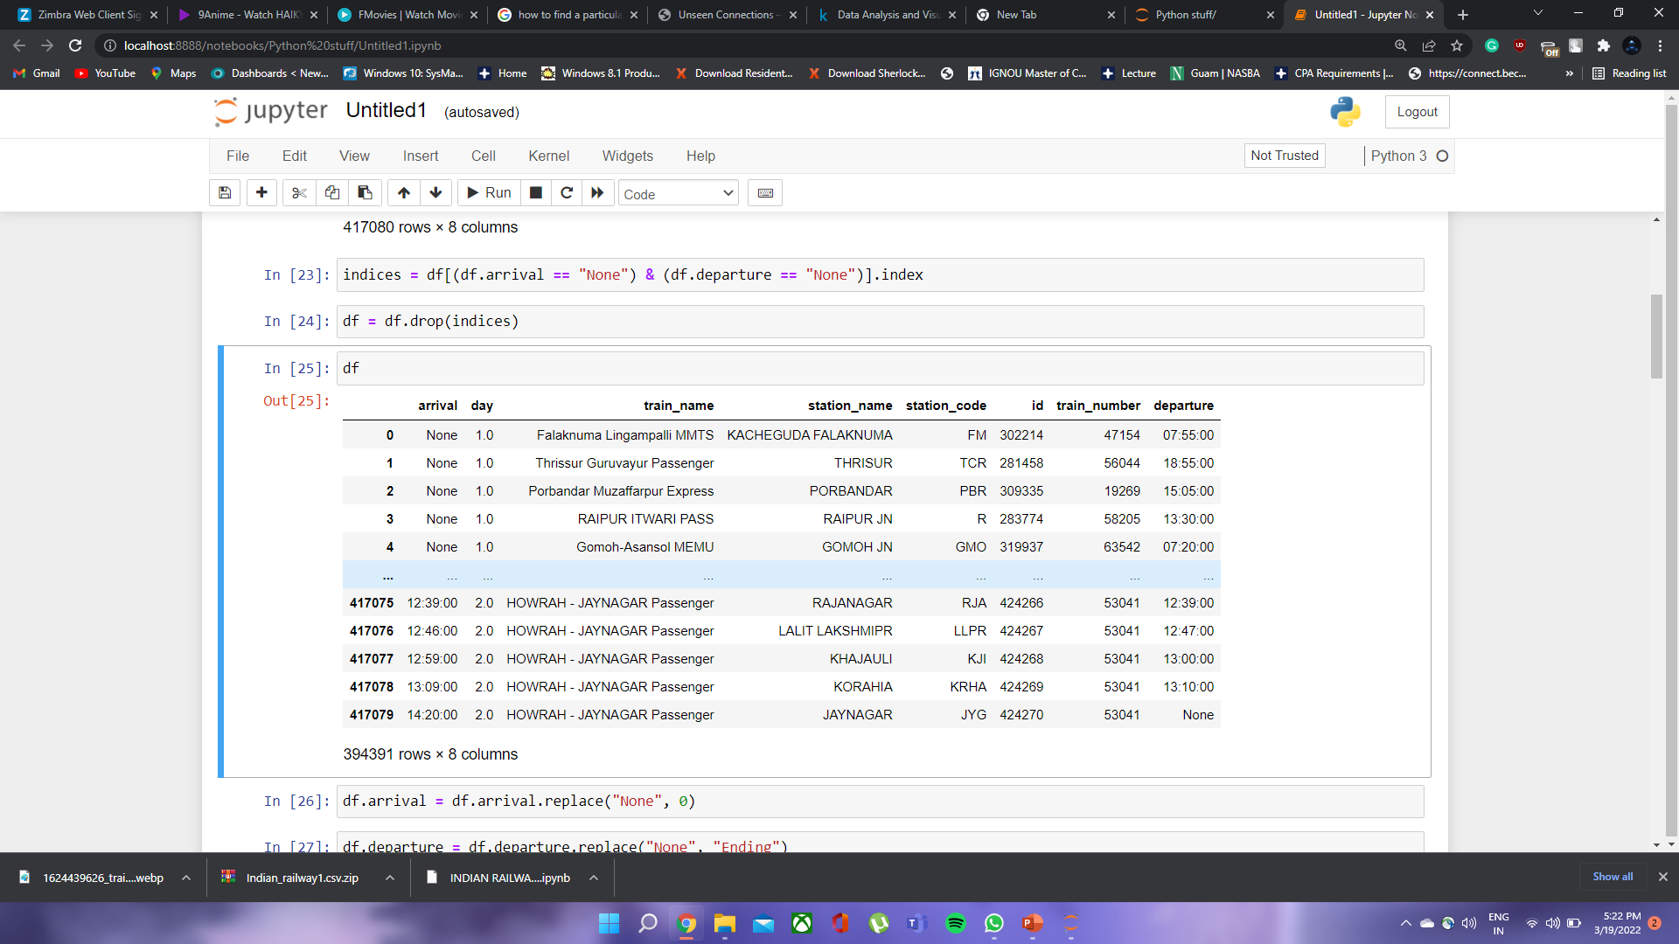
Storing the indices of entries that had “None” in both arrival and departure headings.
Dropping the rows using the indices obtained.

Slide 9
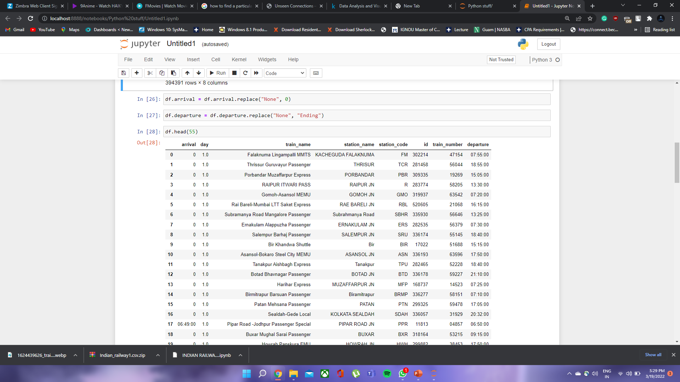
Replacing the entry “None” by “0” in the arrival column (trains start from there).
Replacing the entry “None” by “Ending” in the departure column (trains terminate there).

Slide 10
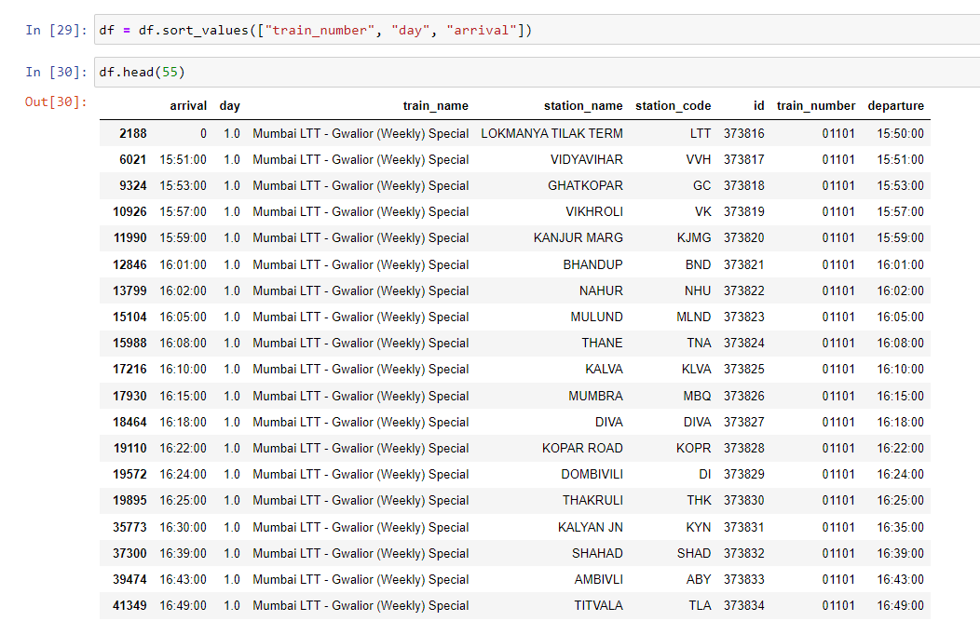
Sorting the data by train number, day and arrival to get better insight on data.

Slide 11
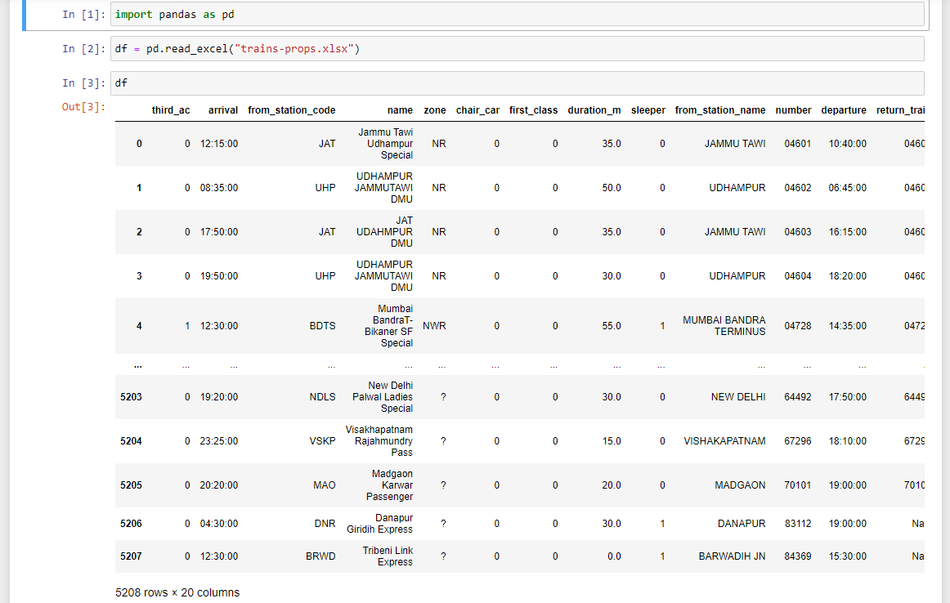
DATA CLEANING OF “TRAINS” DATAFILE :-
Opening the datafile using pandas in jupyter notebook.

Slide 12
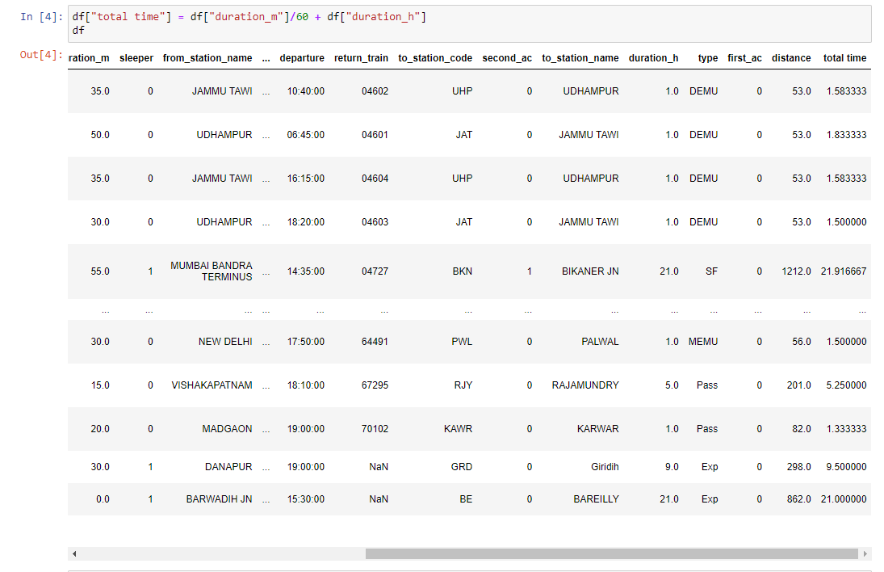
Adding the new column named “total time” which was obtained by converting the “duration_m” in hrs and adding “duration_h” which gives total time of journey.

Slide 13
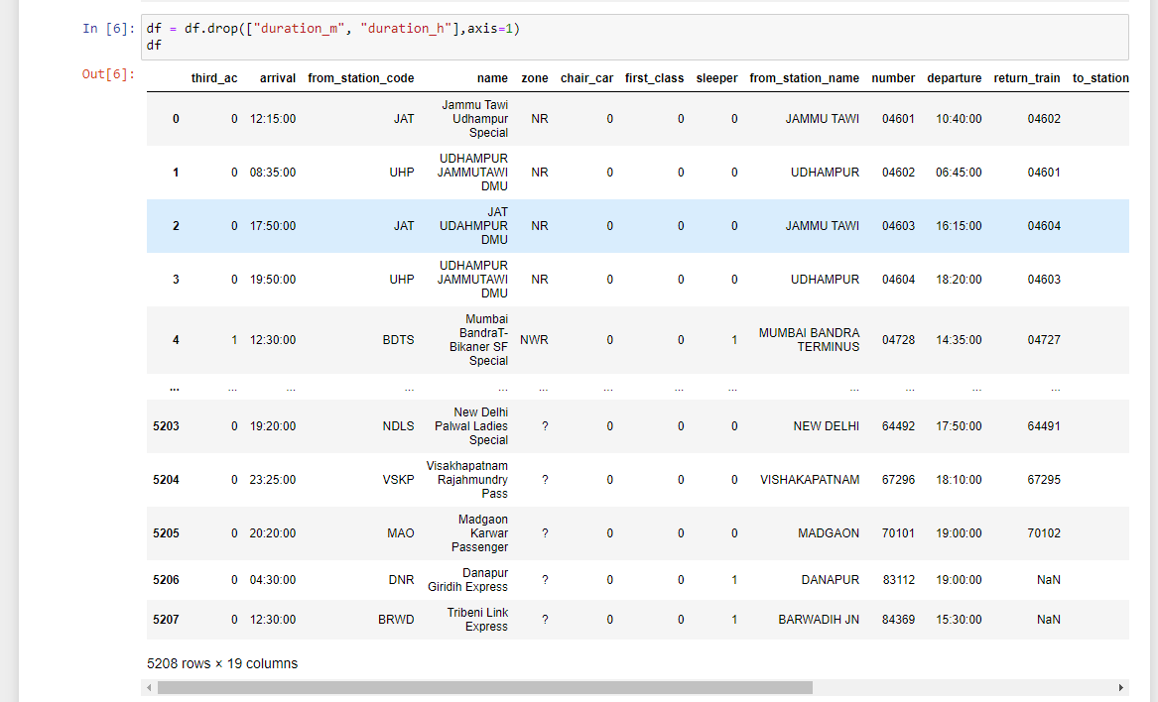
Removed the columns “duration_m” and “duration_h” from the dataset.

Slide 14
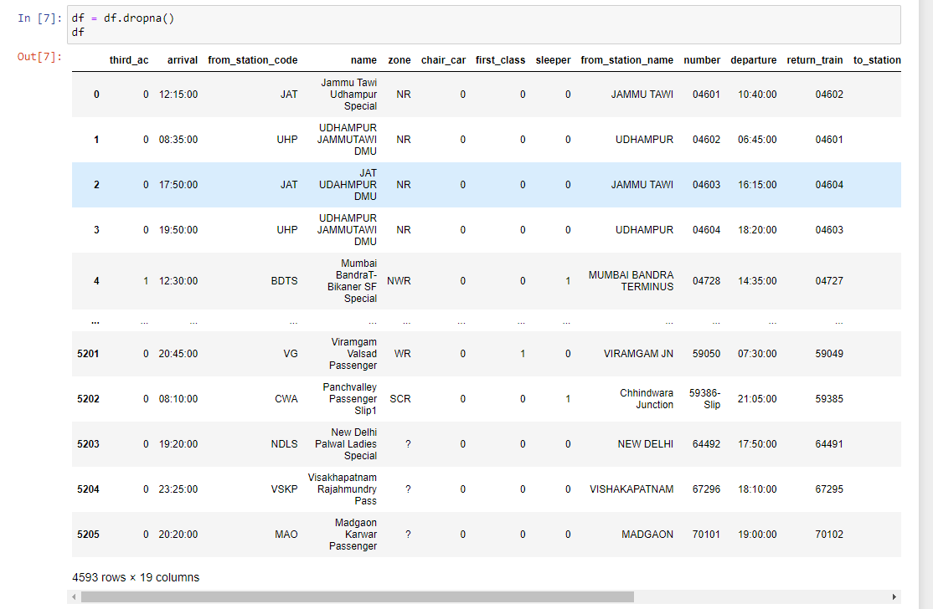
Dropping the rows in which some columns had the entry “NaN” which was incomplete data.

Slide 15
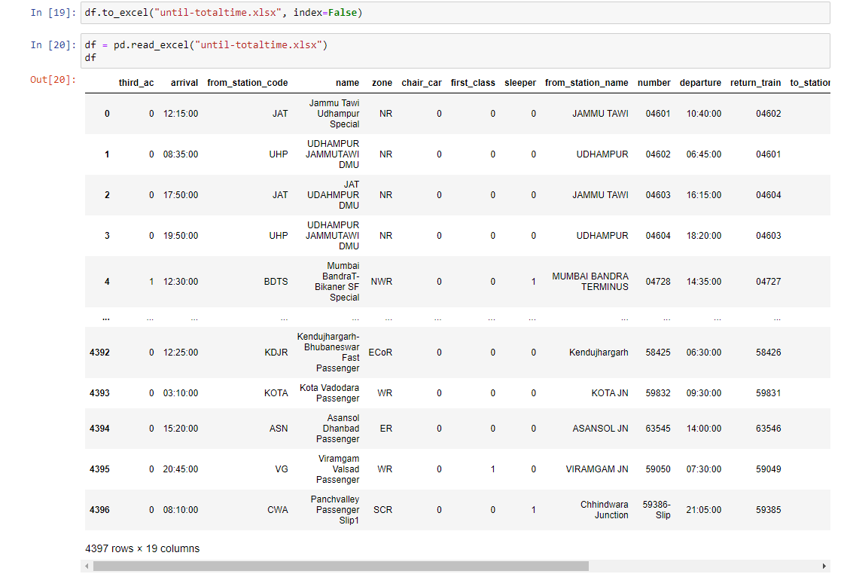
Saving cleaned data to an excel file.

Slide 16
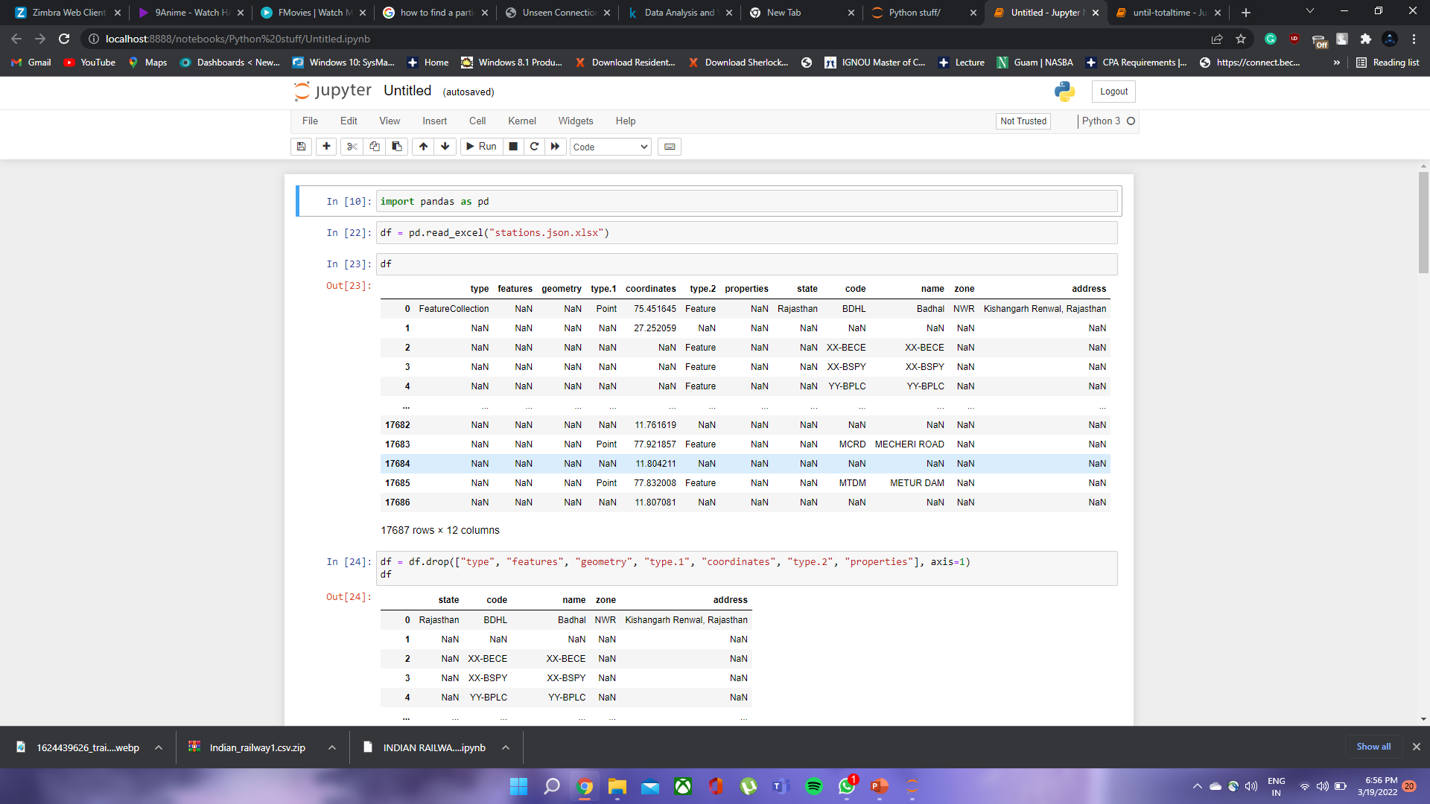
DATA CLEANING OF “STATIONS” DATAFILE :-
Opening the datafile using pandas in jupyter notebook.

Slide 17
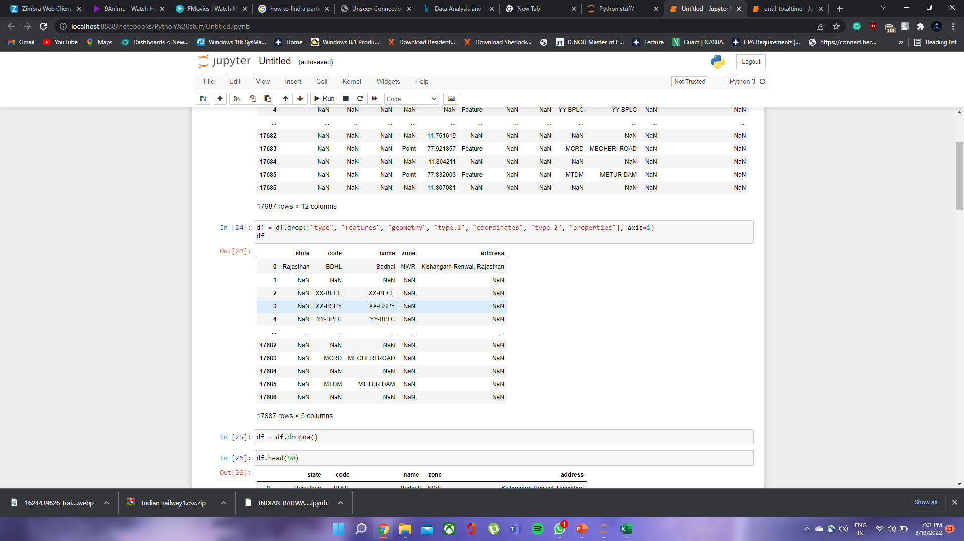
Removing the columns named “type”, “features”, “geometry”, “type.1”, “coordinates”, “type.2” and “properties” Which had NaN entries and were not required by further steps.

Slide 18
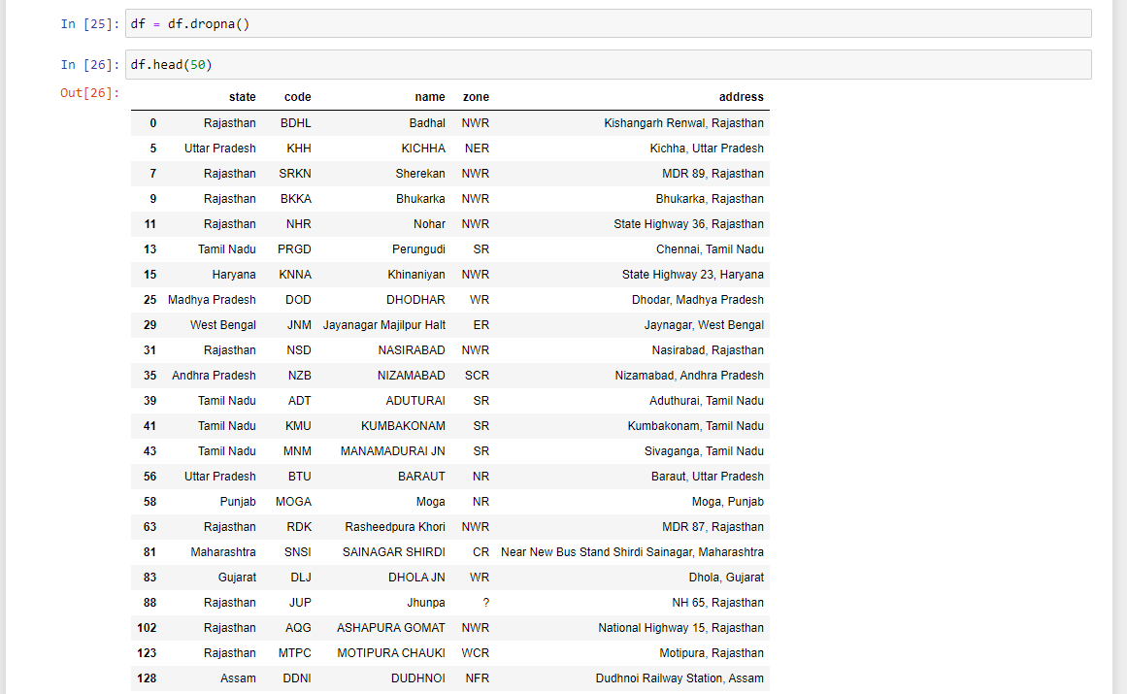
Removing the extra rows with some columns having entry “NaN” (incomplete) to make dataset more workable

Slide 19
Data visualization

Slide 20
Now in this step, we have visualize the data in many graphs to compare different stats of Indian railways.
We have also taken some insight on Rajdhani trains.

Slide 21
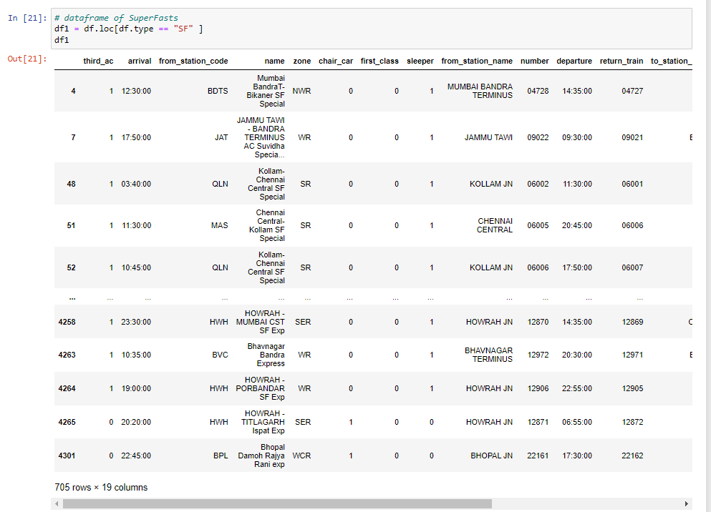
Zone vs Time Graph for Superfast trains
Firstly we sorted the data for Superfast trains to make graph.

Slide 22
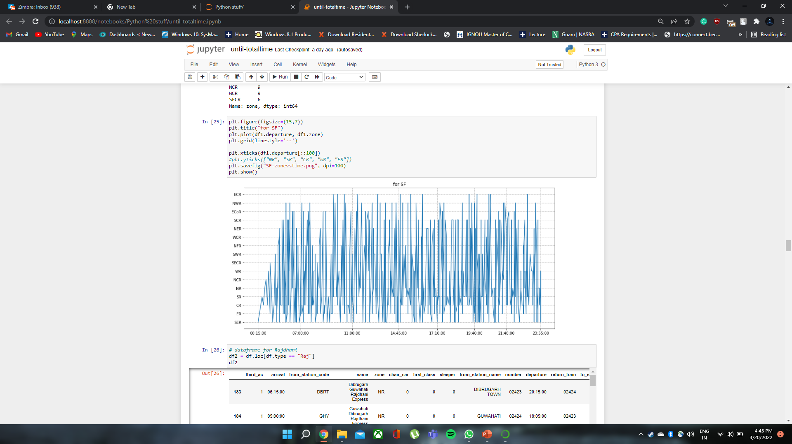
At this particular point, we can notice the train position in space and time
Railway zone
Time

Slide 23
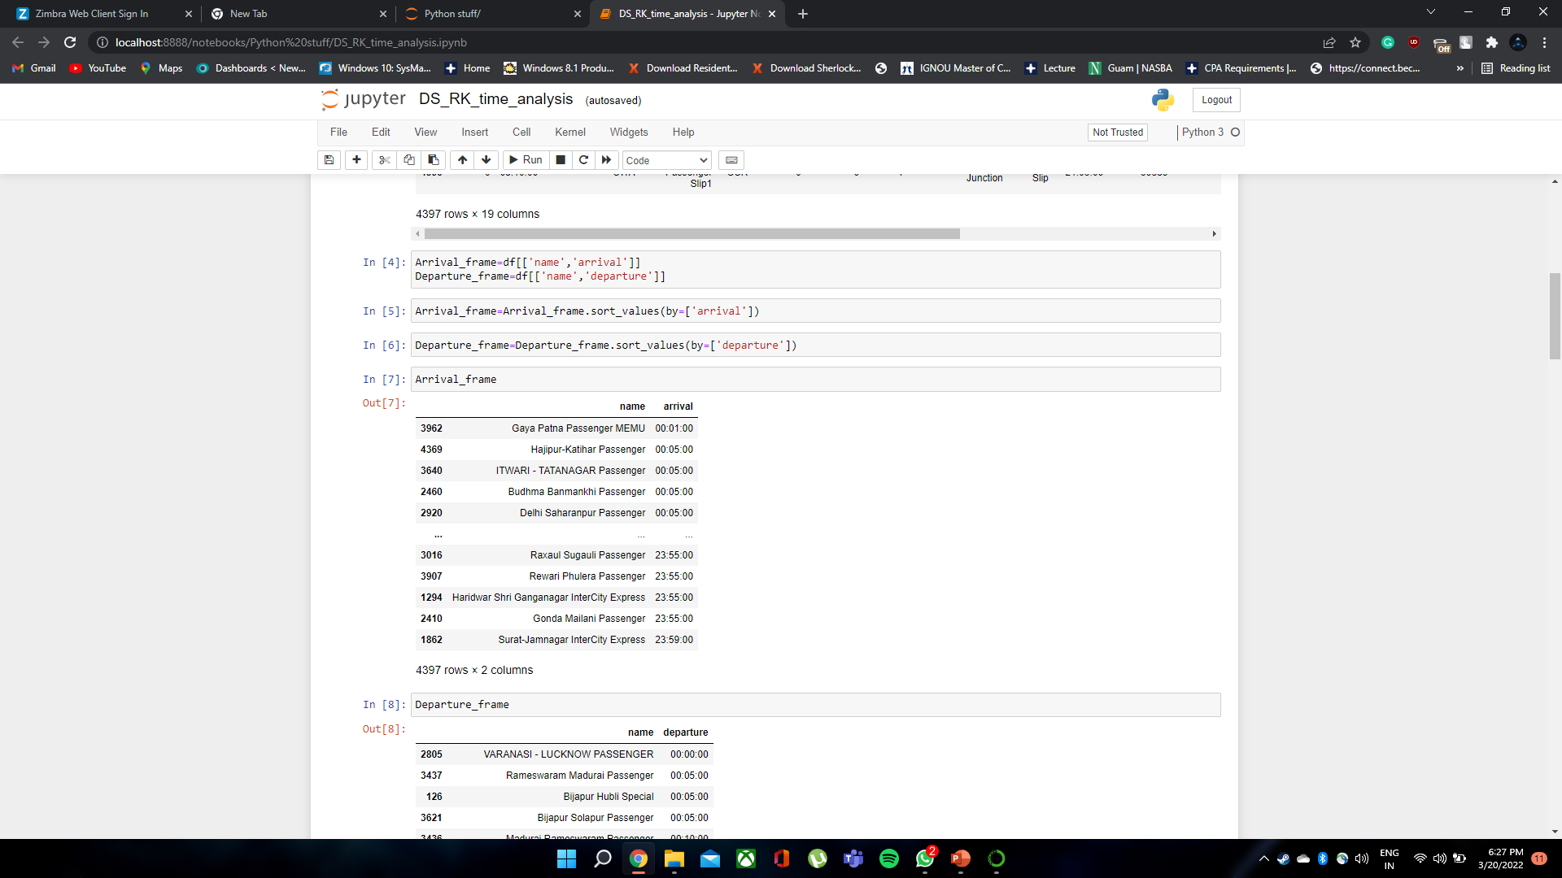
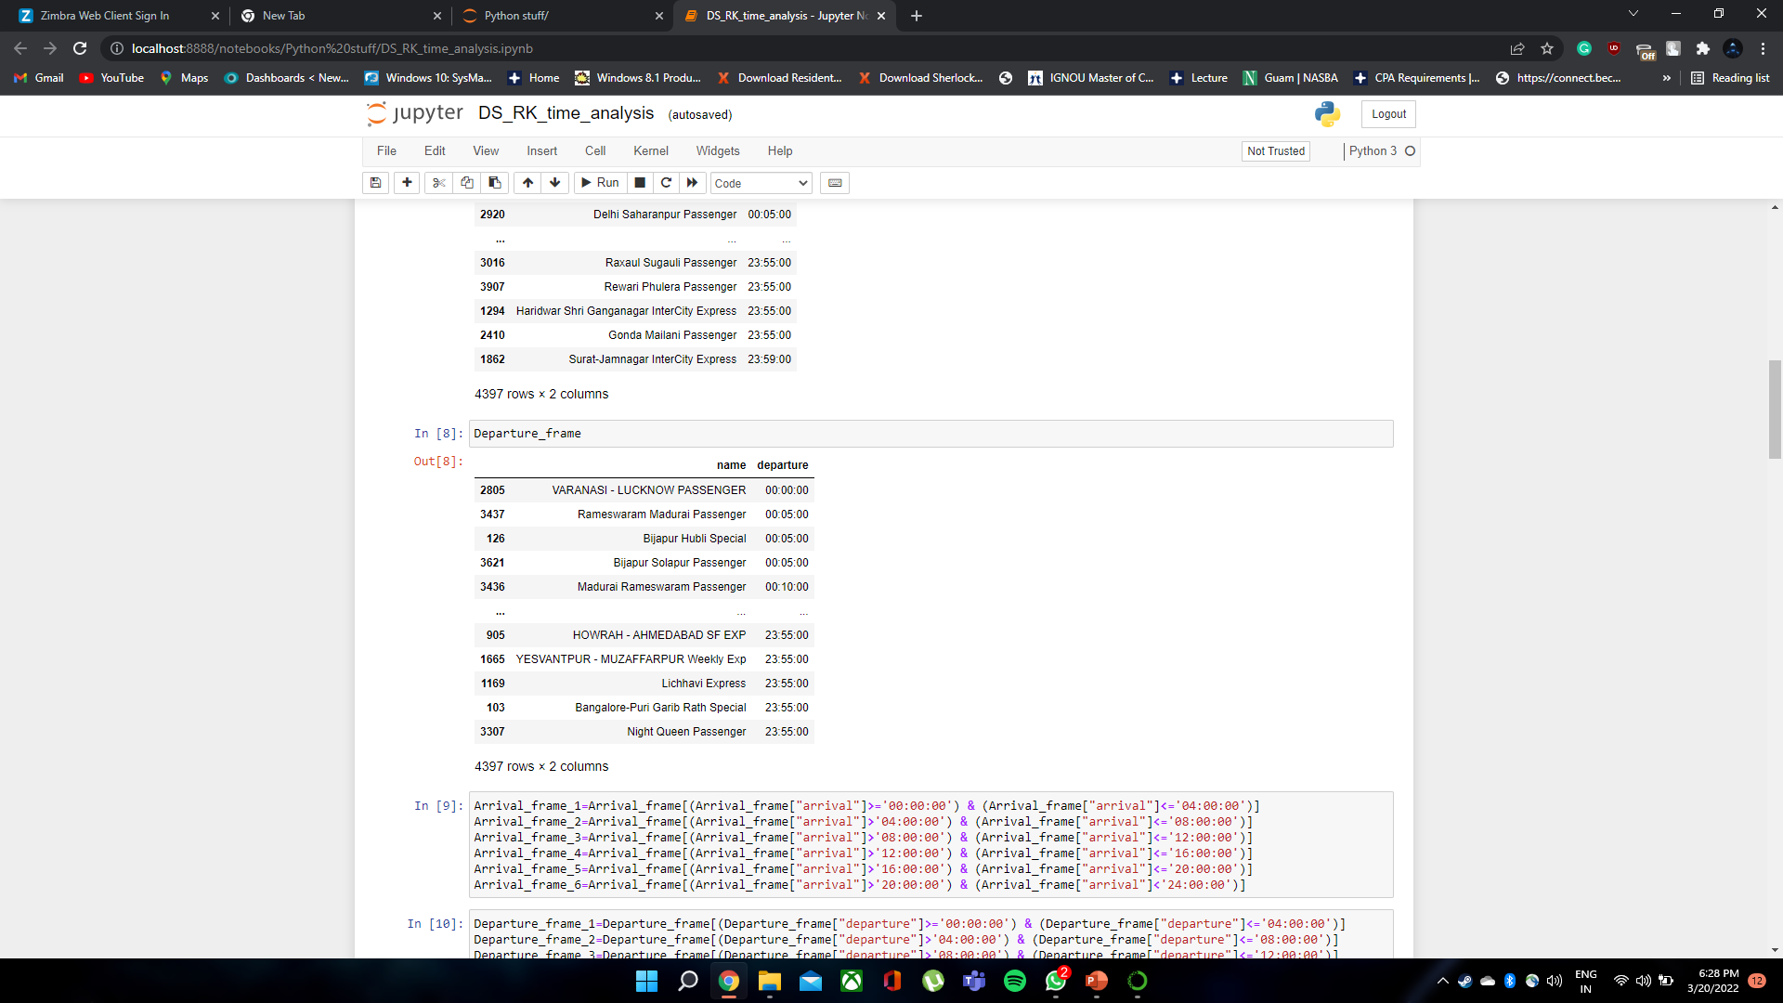
Time wise – Train traffic
Creating two frames with arrival and departure times

Slide 24
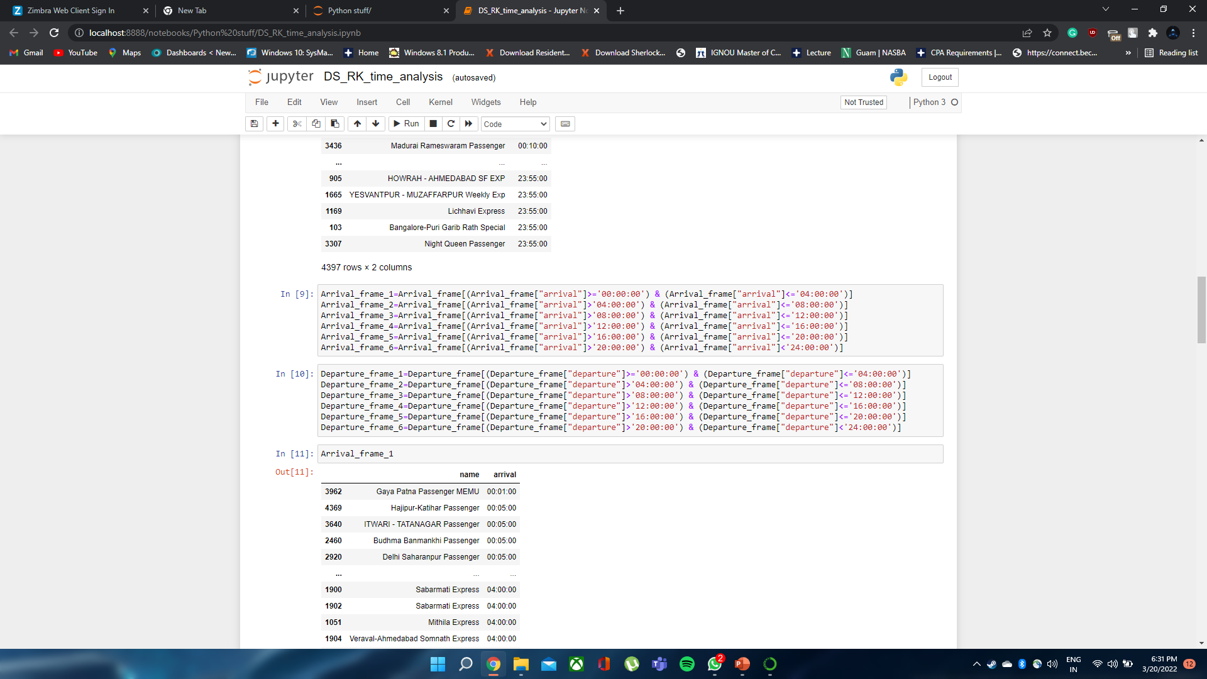
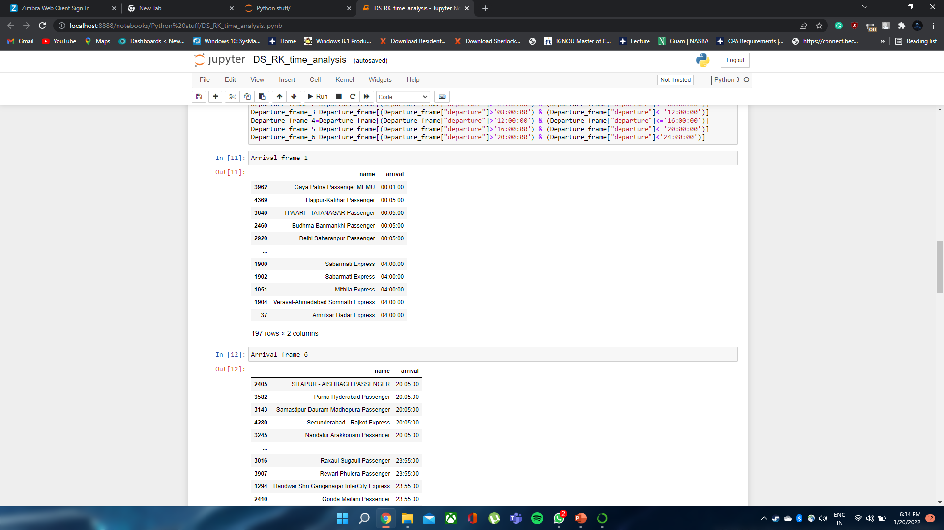
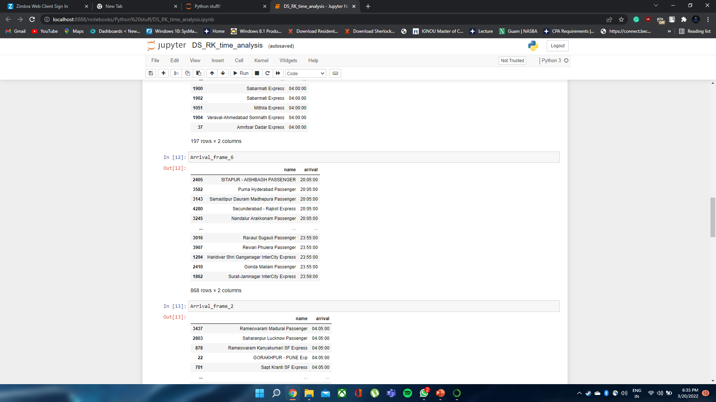
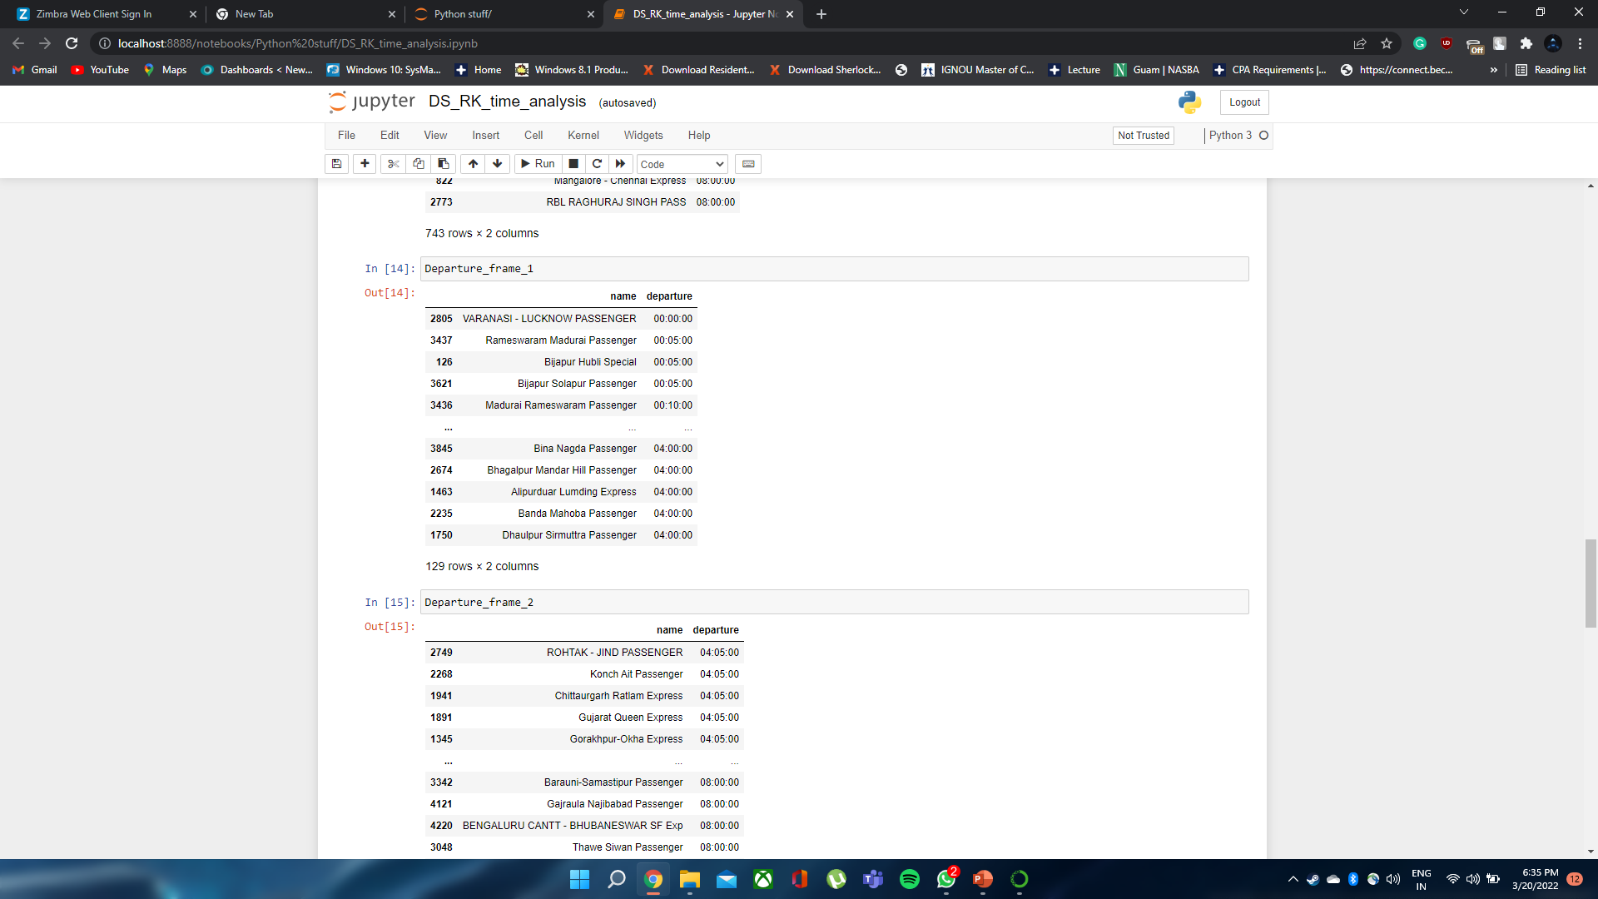
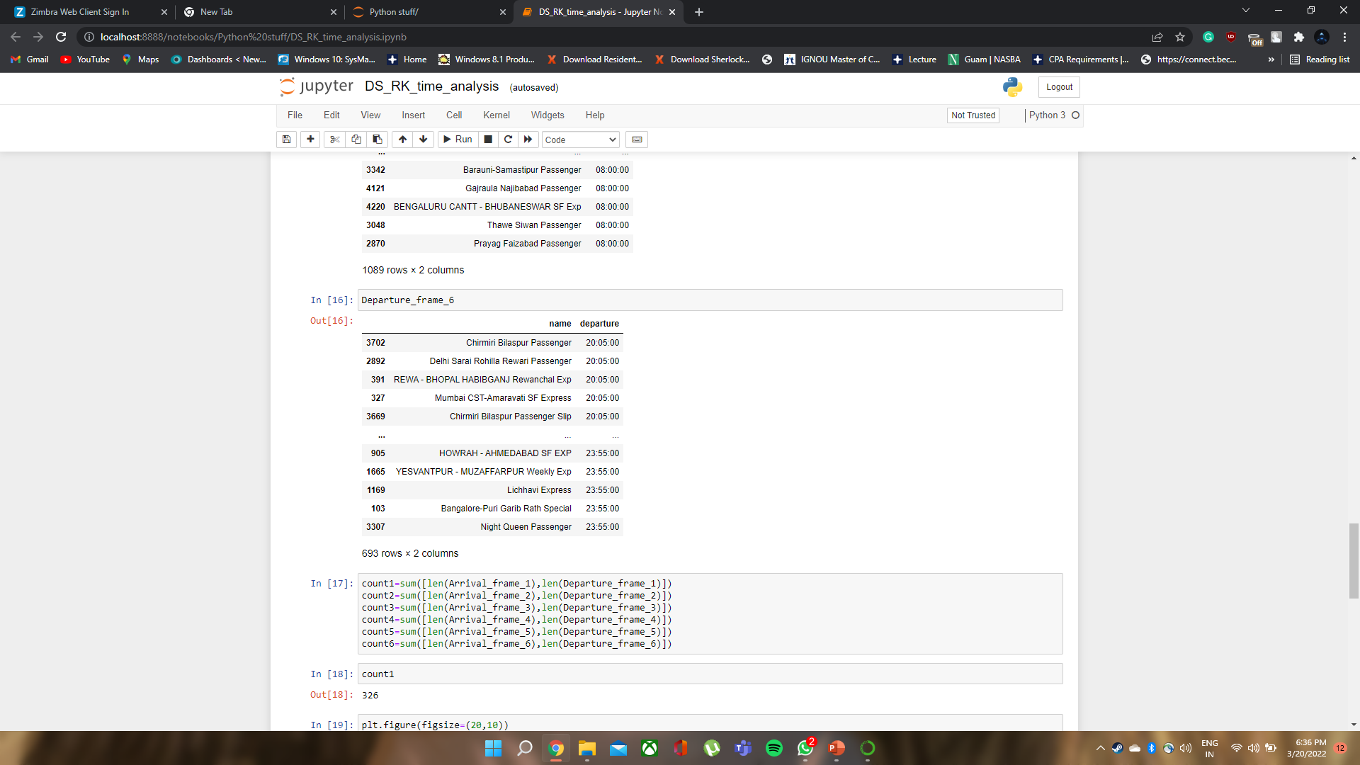
Now dividing the both frame in six frames by taking time interval of 4 hrs.

Slide 25
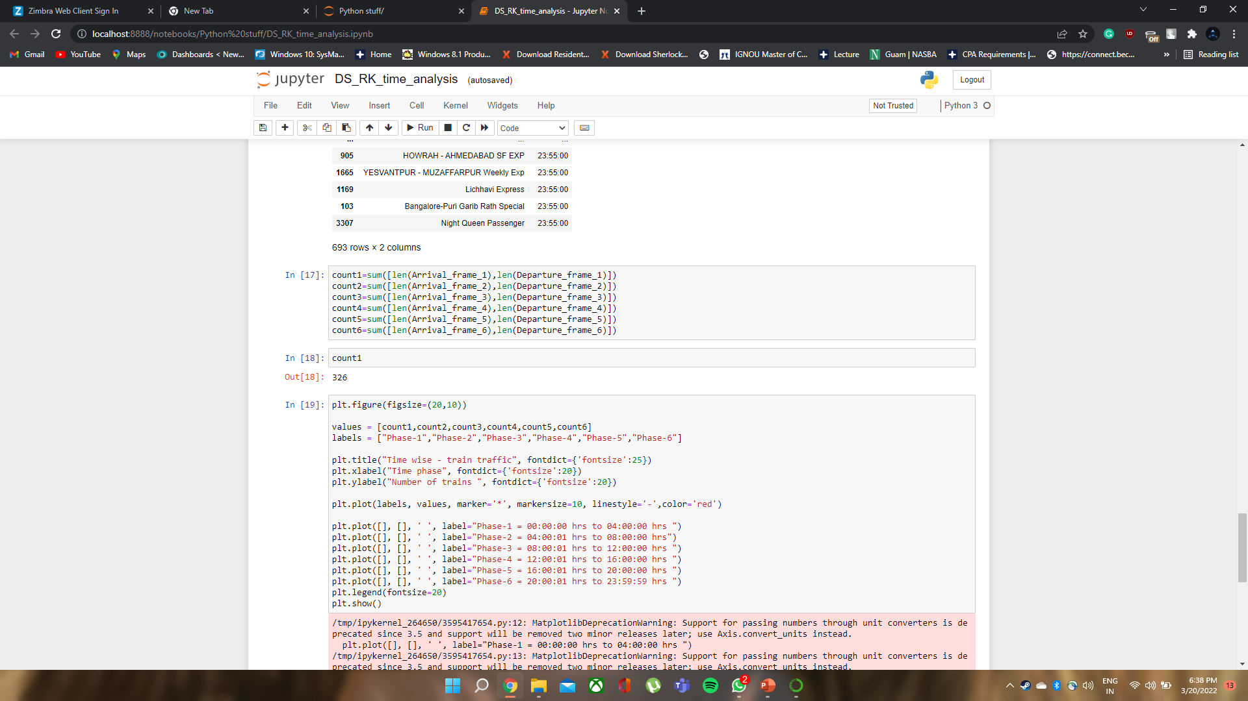
Counting no of trains in each time frame of 4 hrs.
Now plotting the graph of Time wise – Train traffic

Slide 26
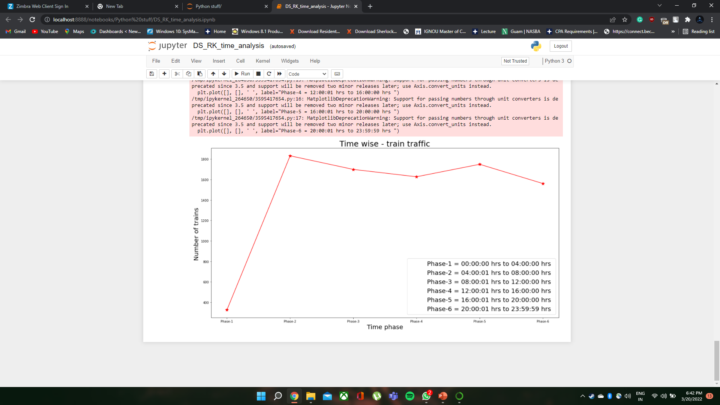

Slide 27
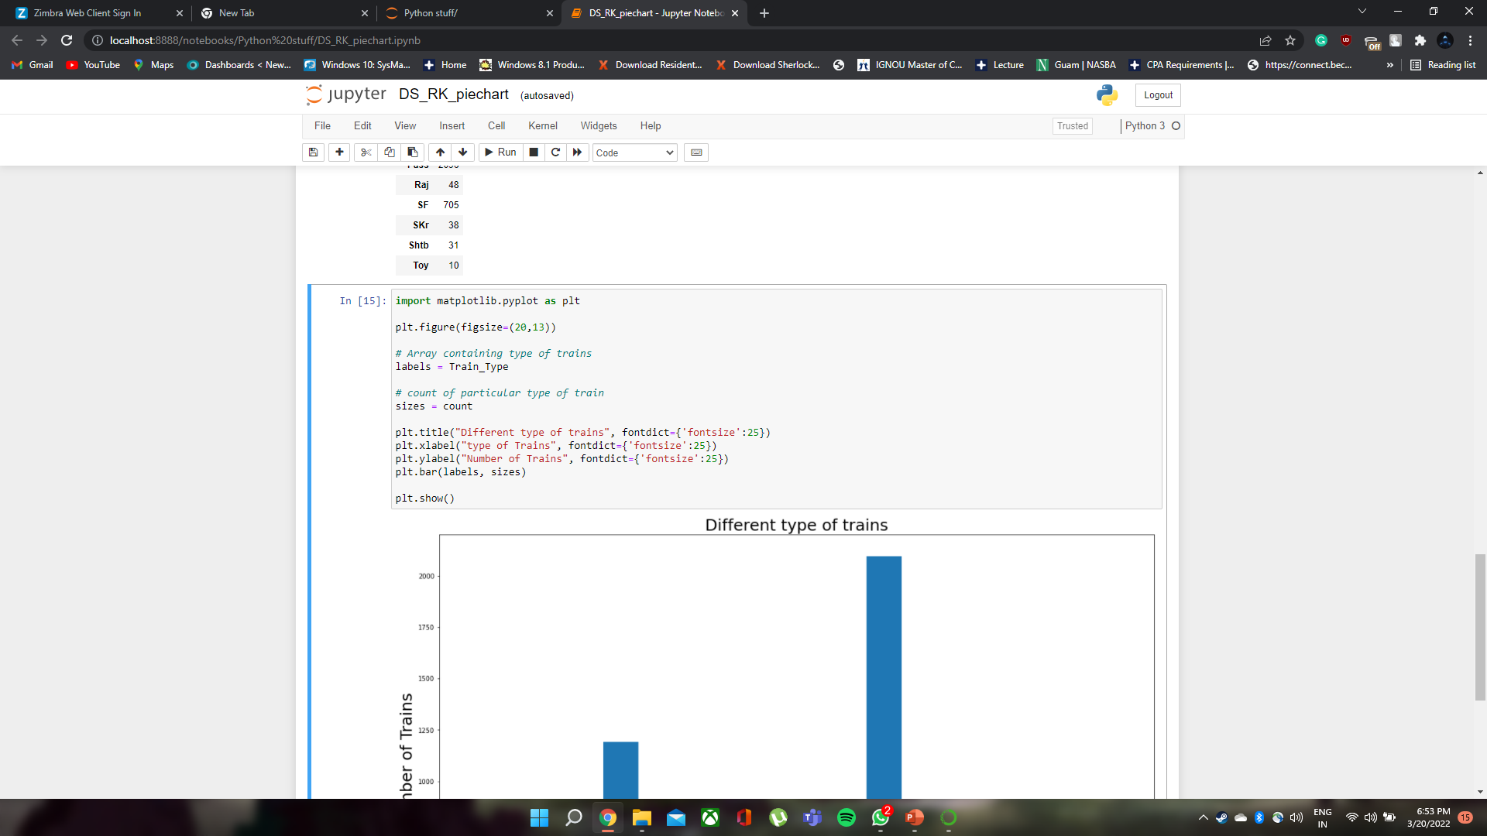
Distribution of different types of trains

Slide 28
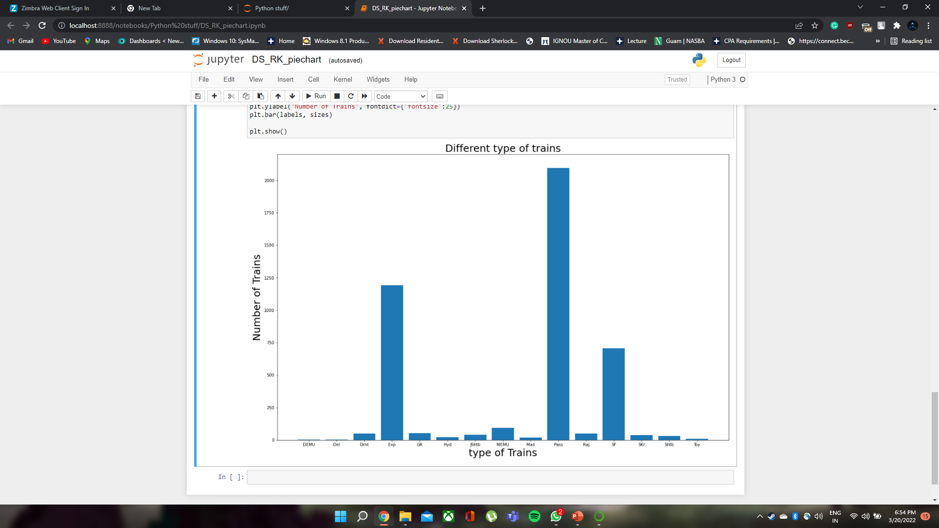

Slide 29
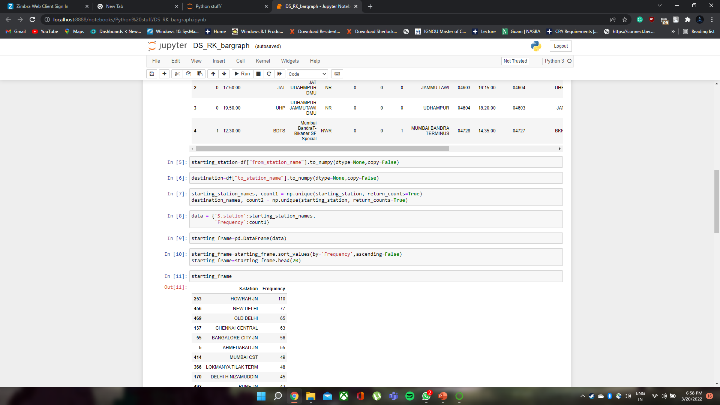
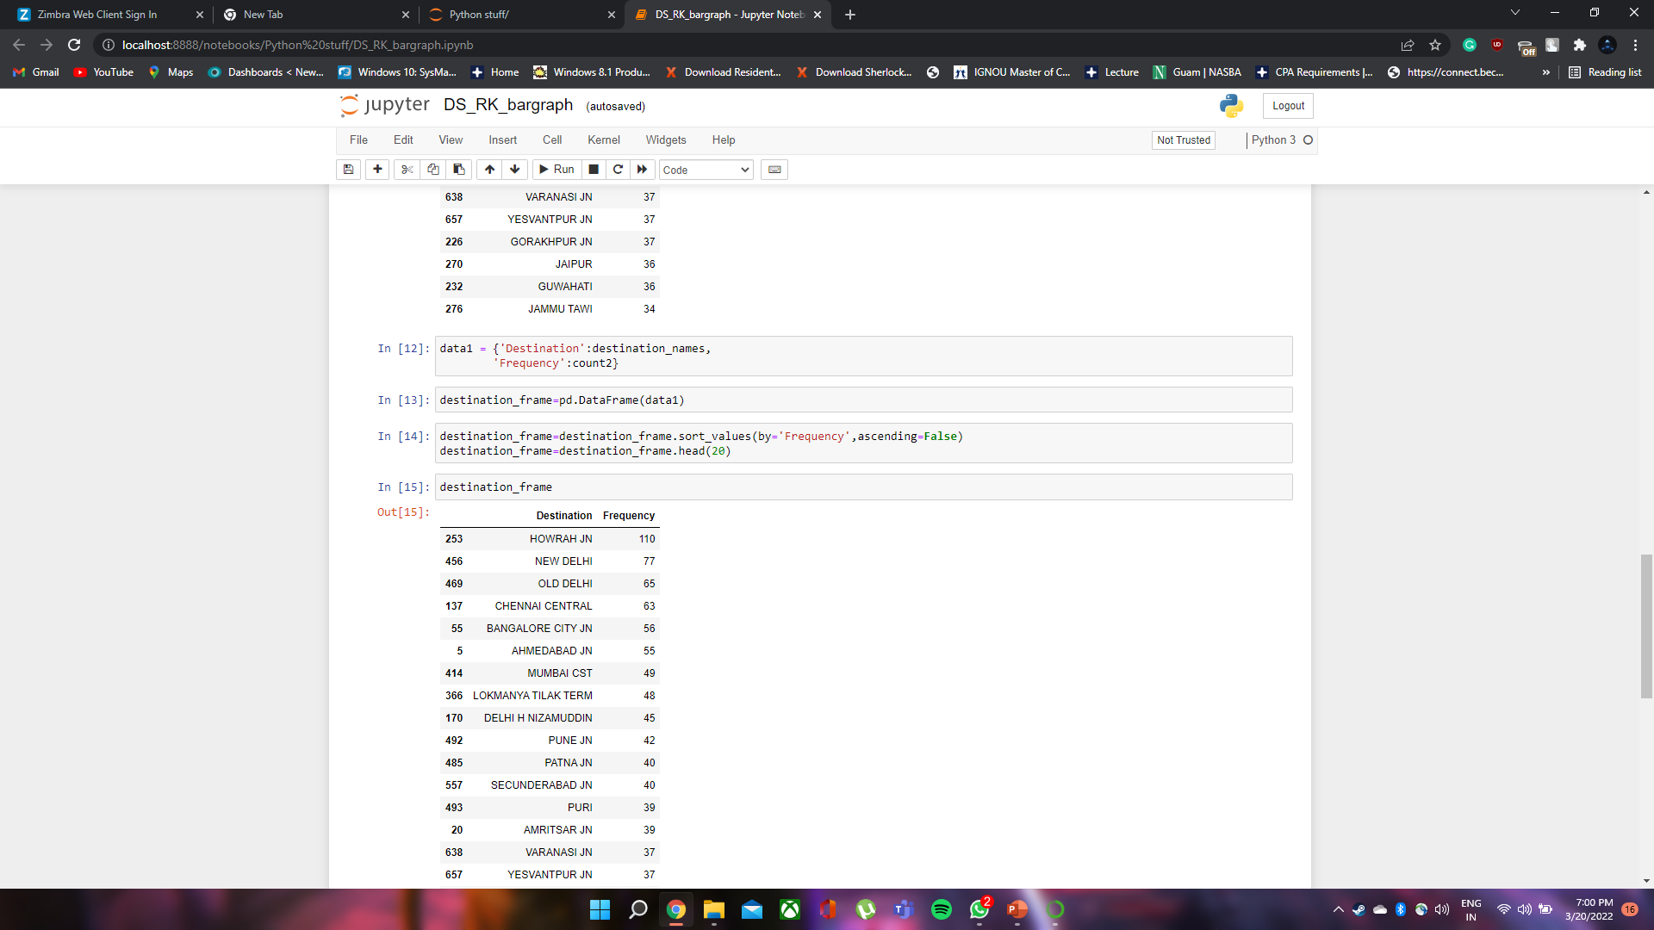
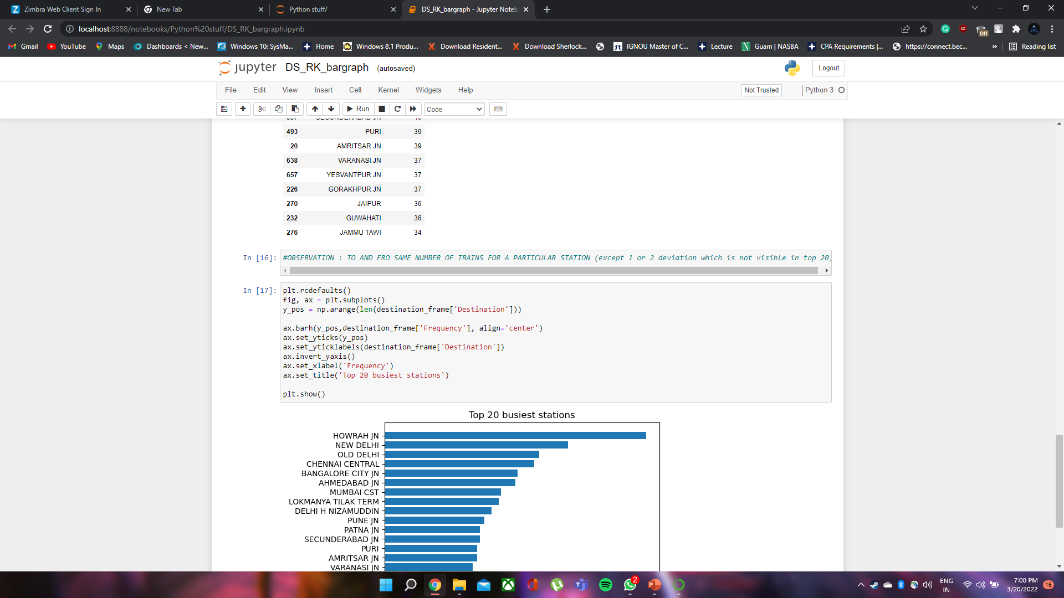
Top 20 busiest stations

Slide 30
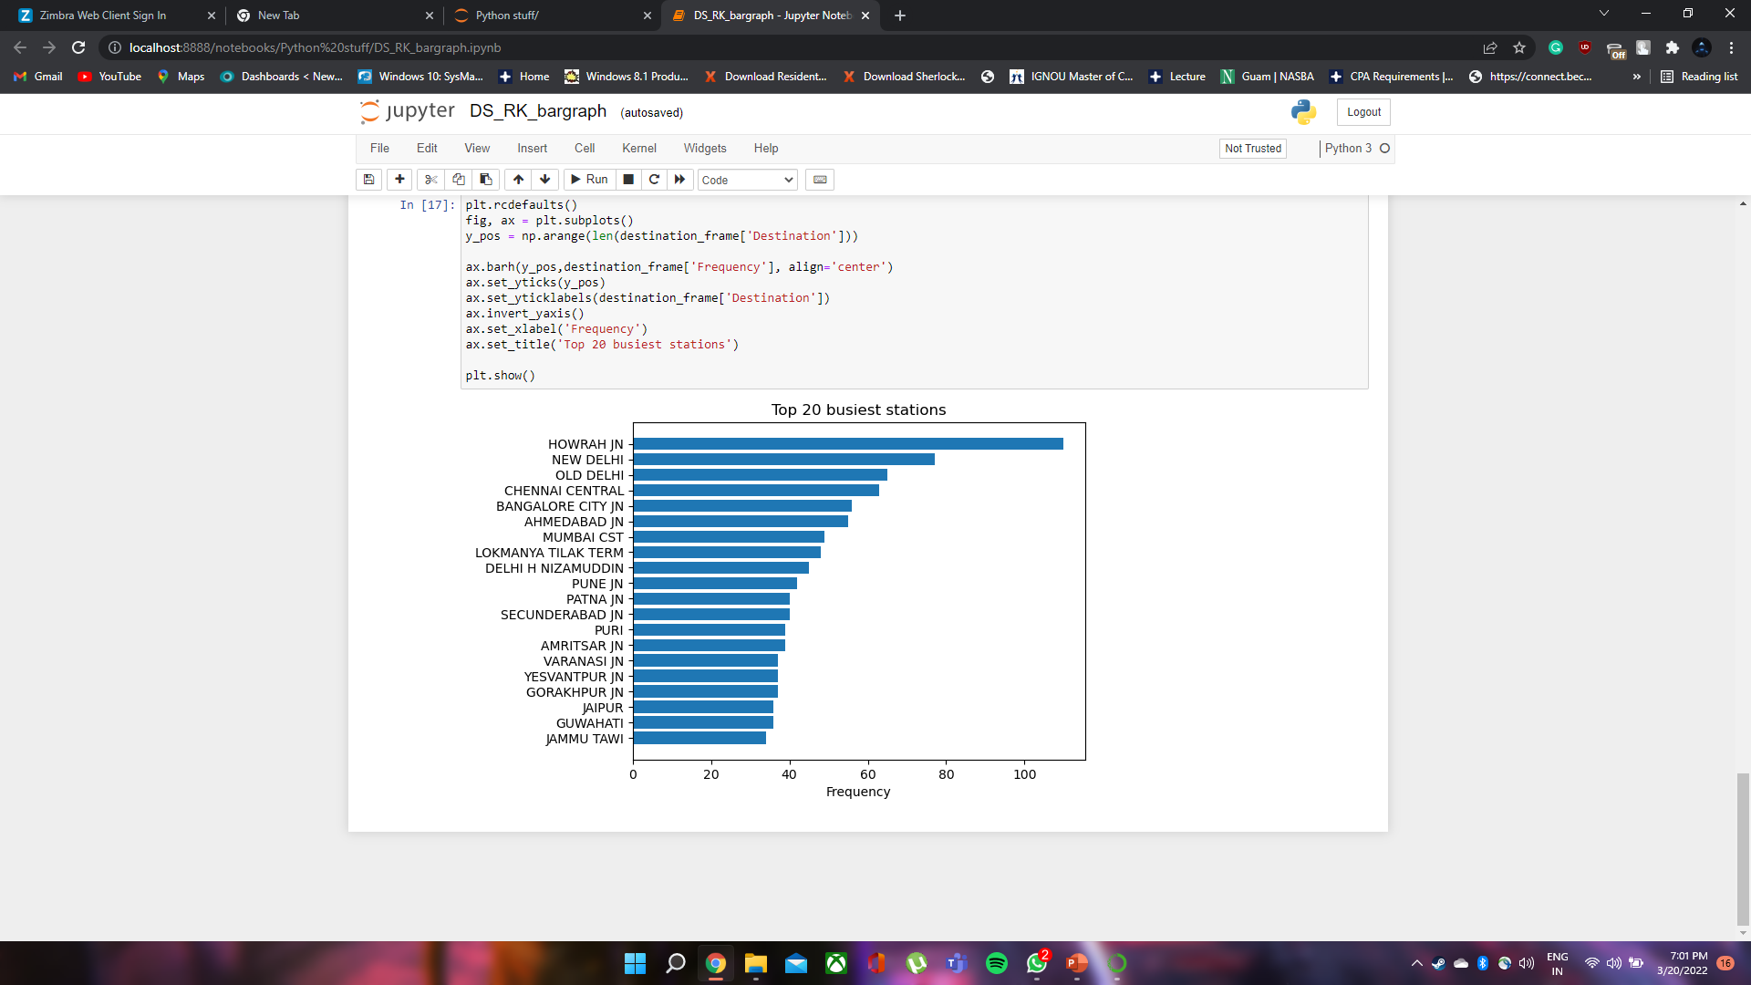

Slide 31
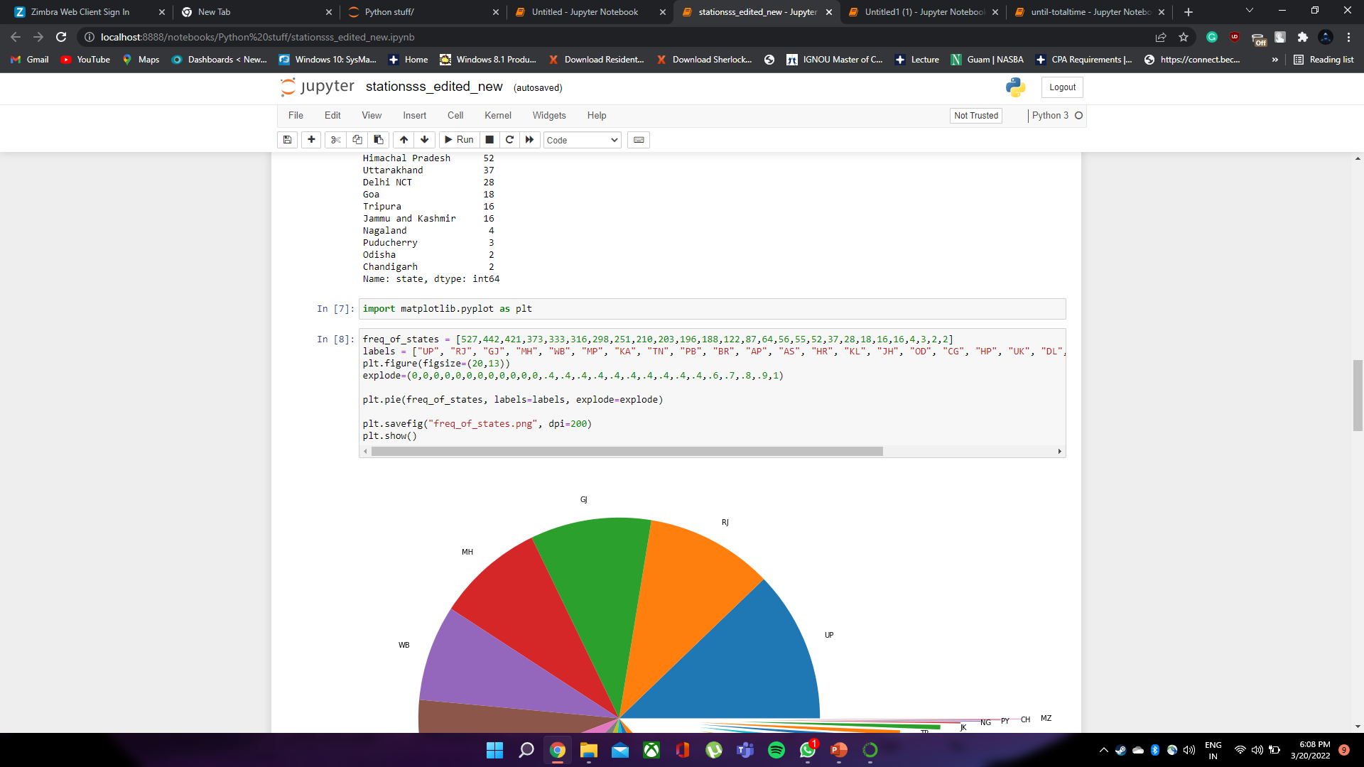
Distribution of number of stations in States

Slide 32
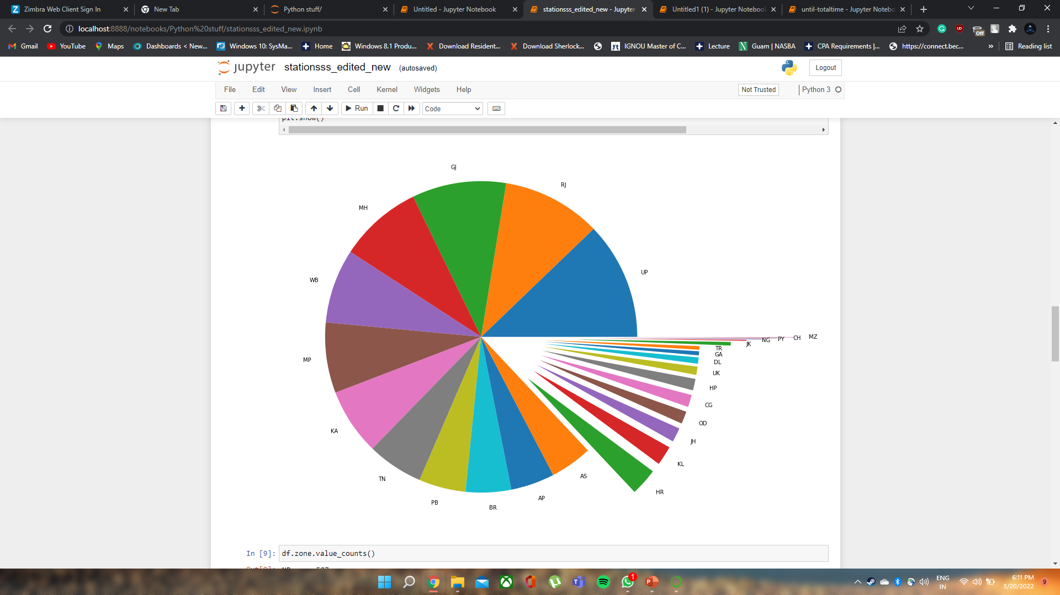

Slide 33
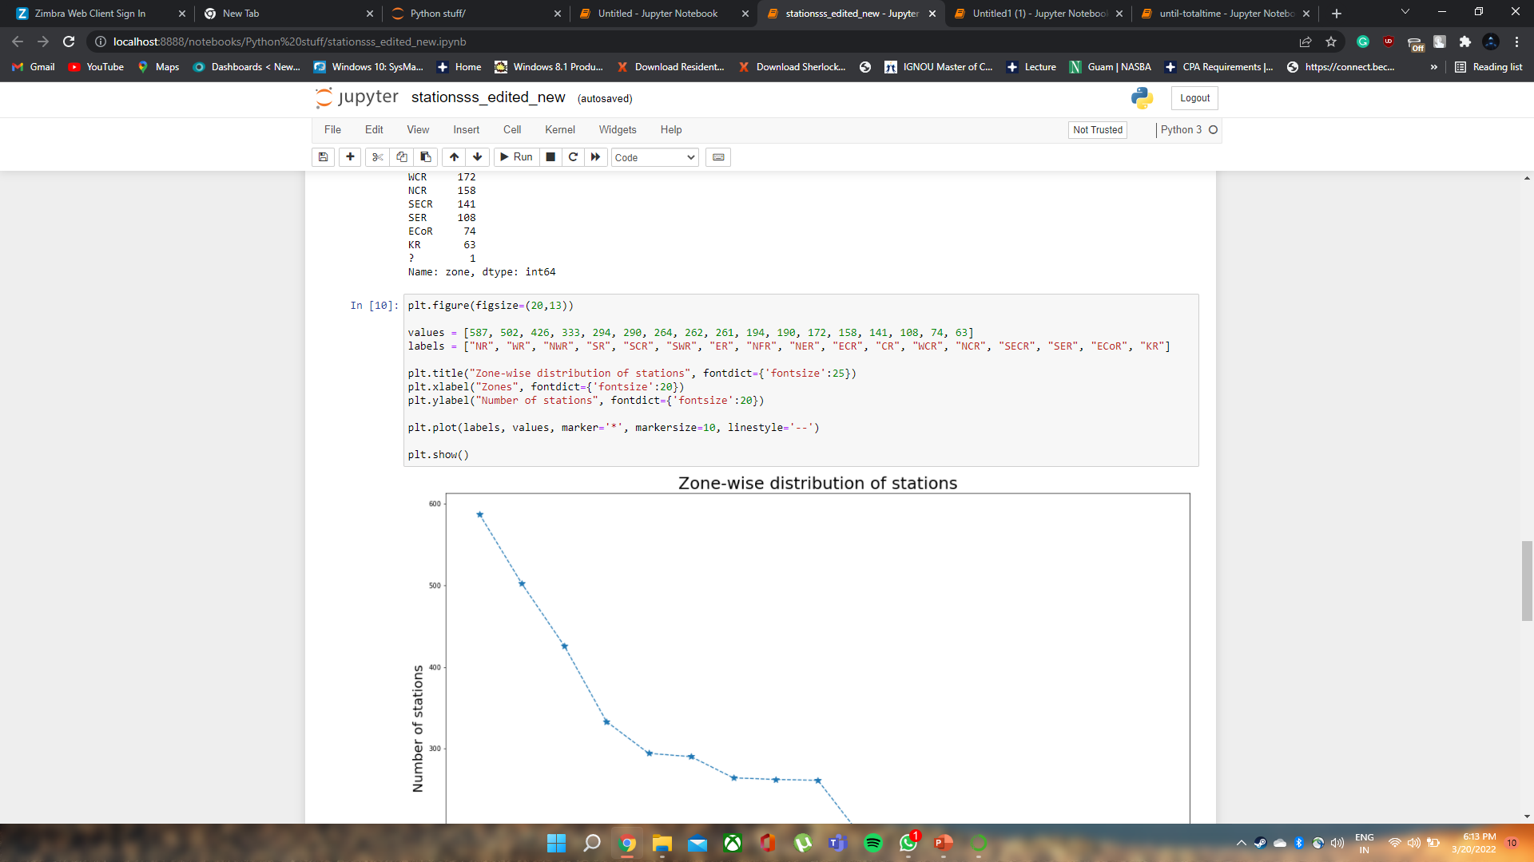
Distribution of number of stations in Railway zones

Slide 34
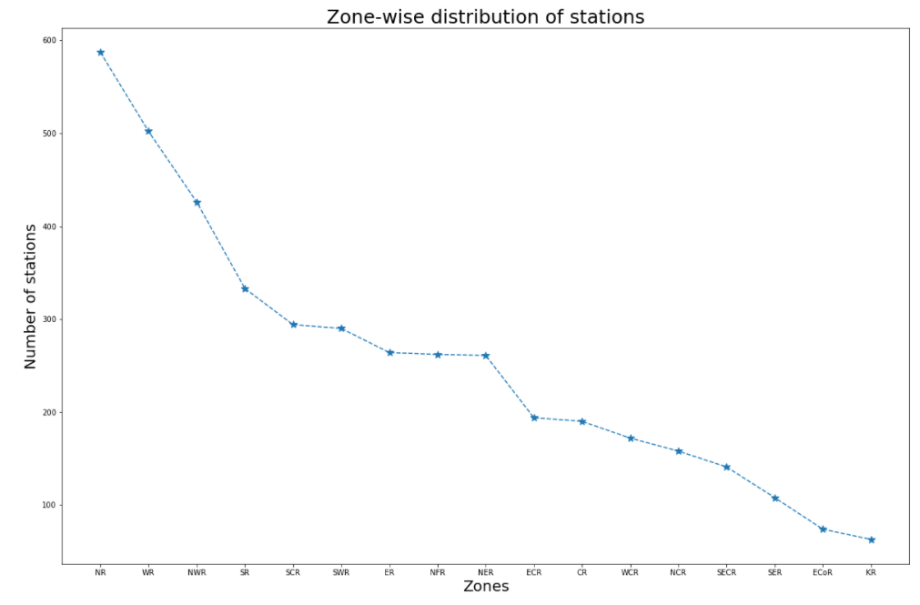

Slide 35
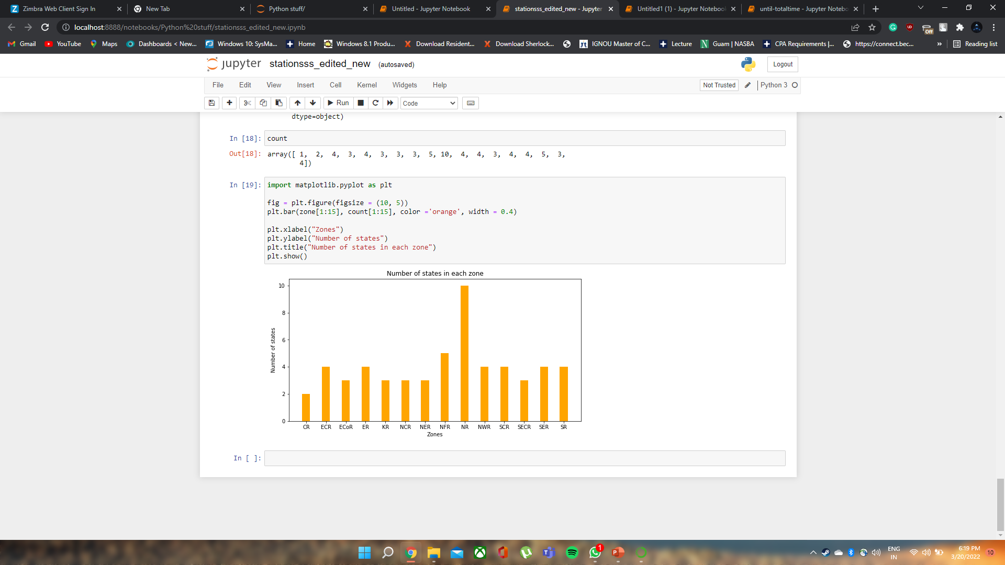
Distribution of number of states in Railway zones

Slide 36
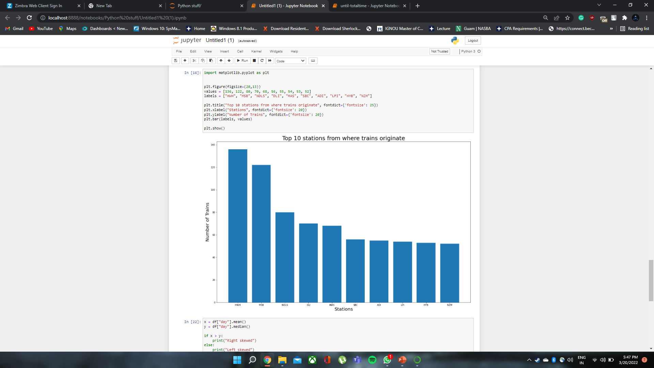
Distribution of Stations from which most trains orginates.

Slide 37
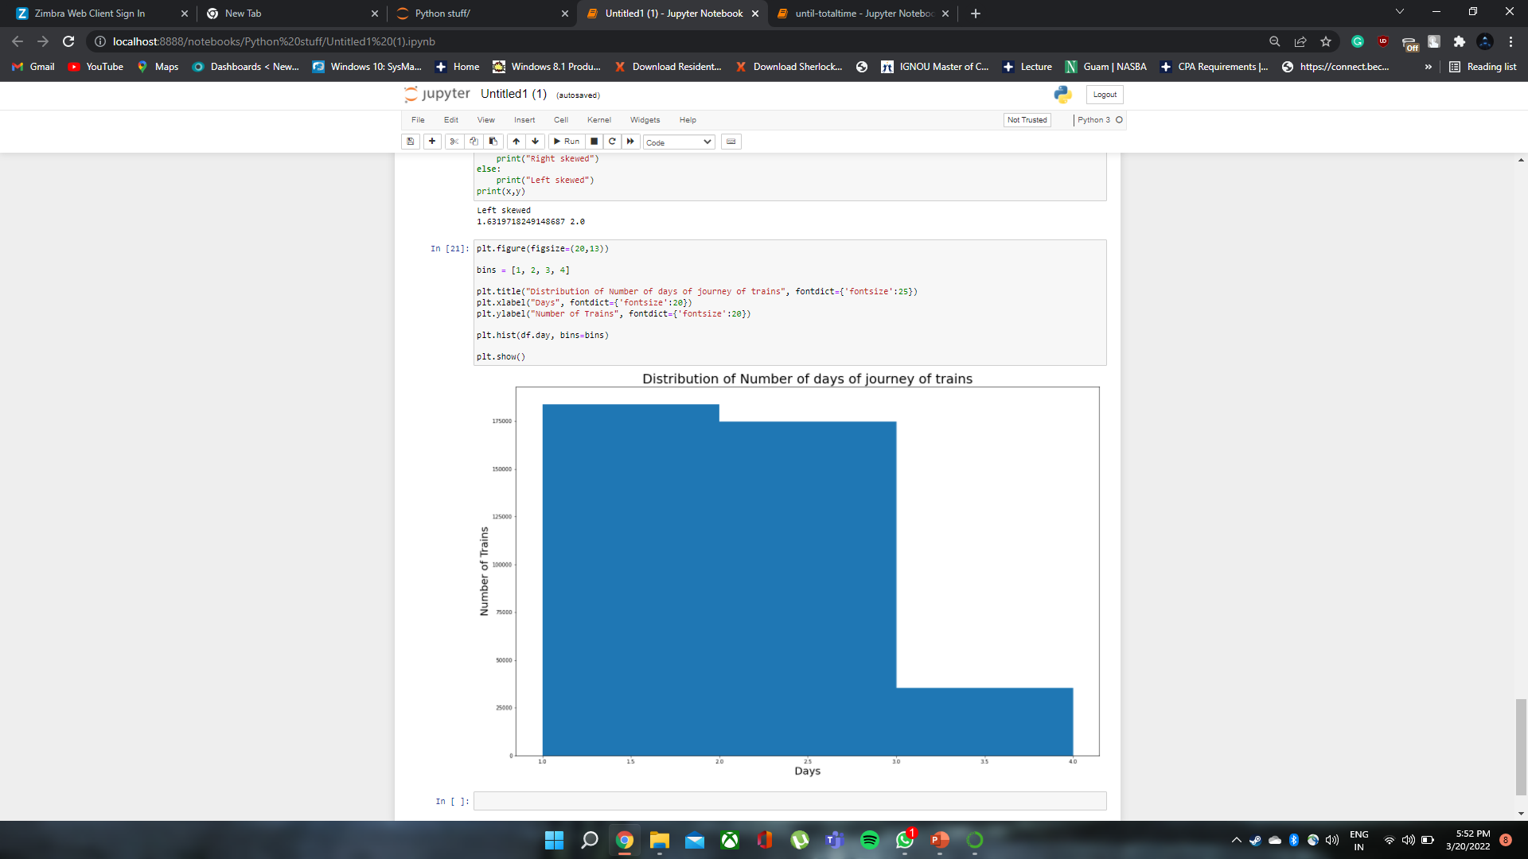
Distribution of Number of days of journey of trains

Slide 38
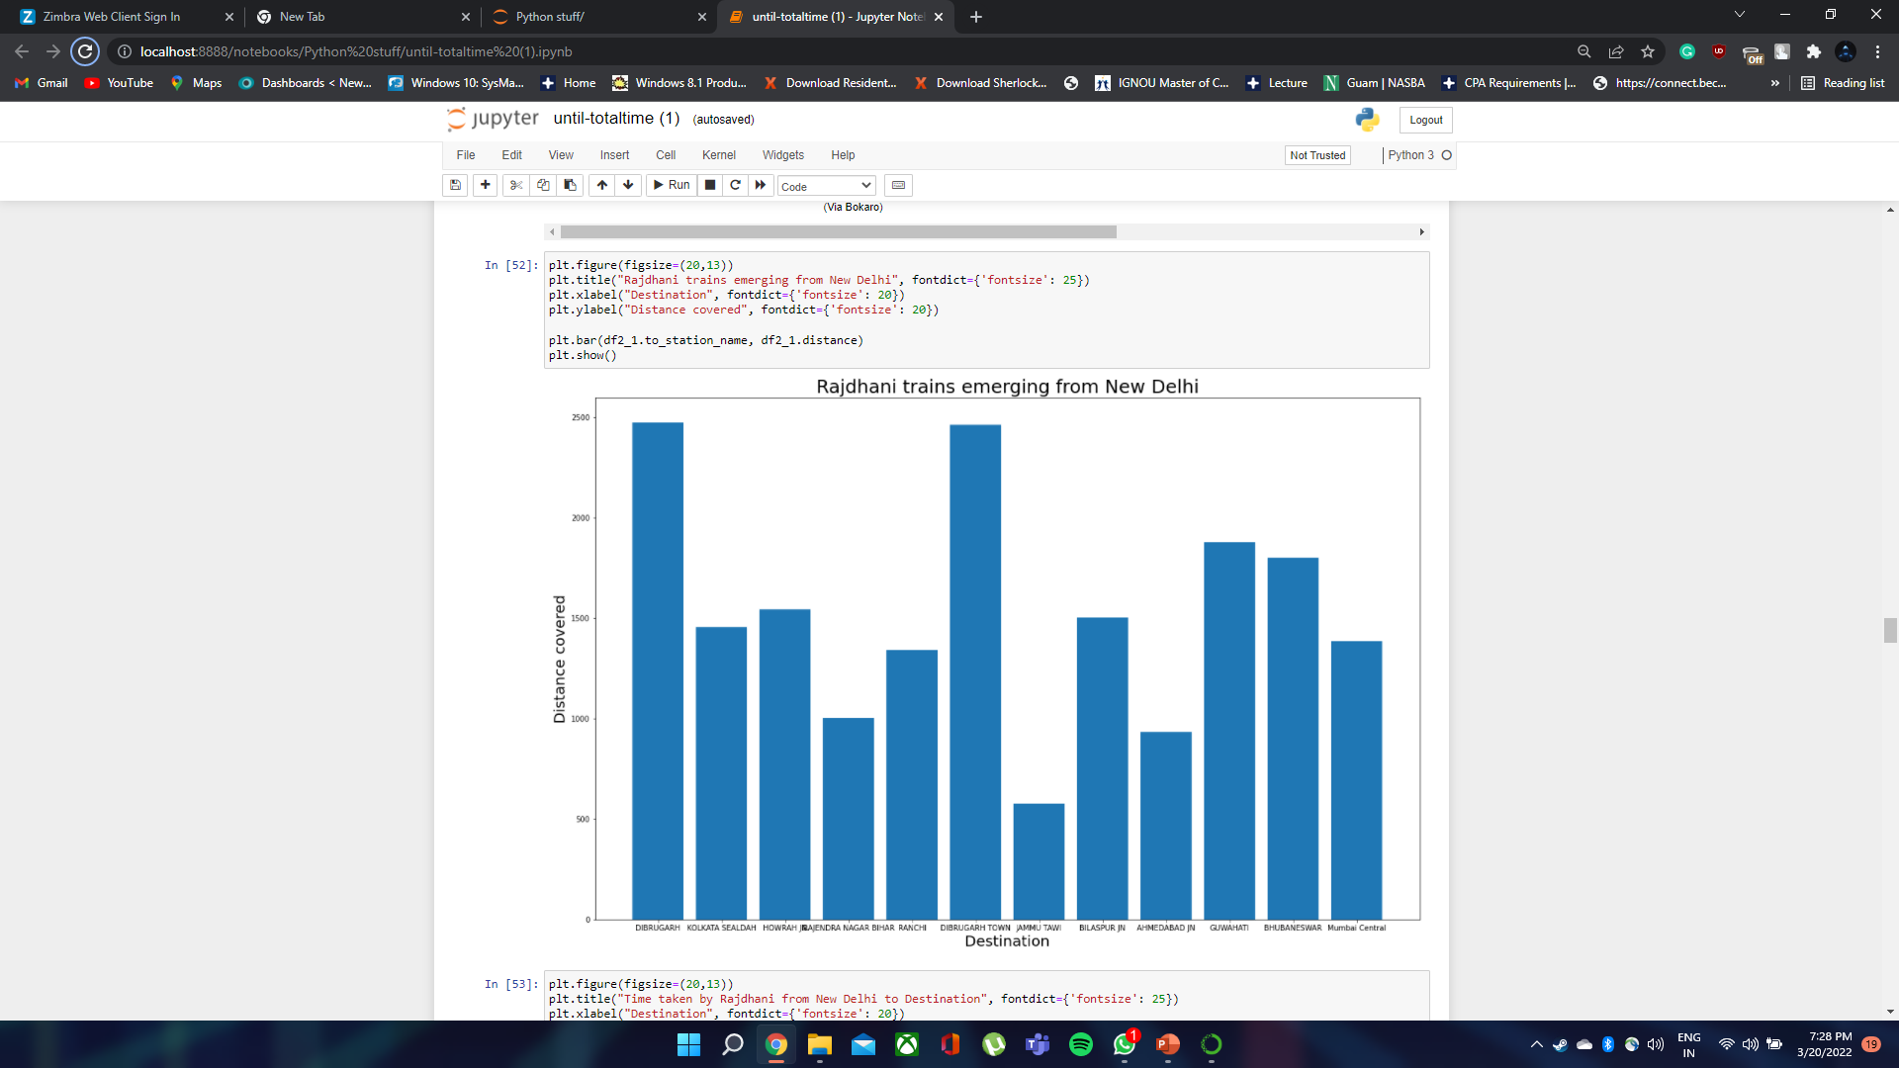
Insight on Rajdhani Trains

Slide 39
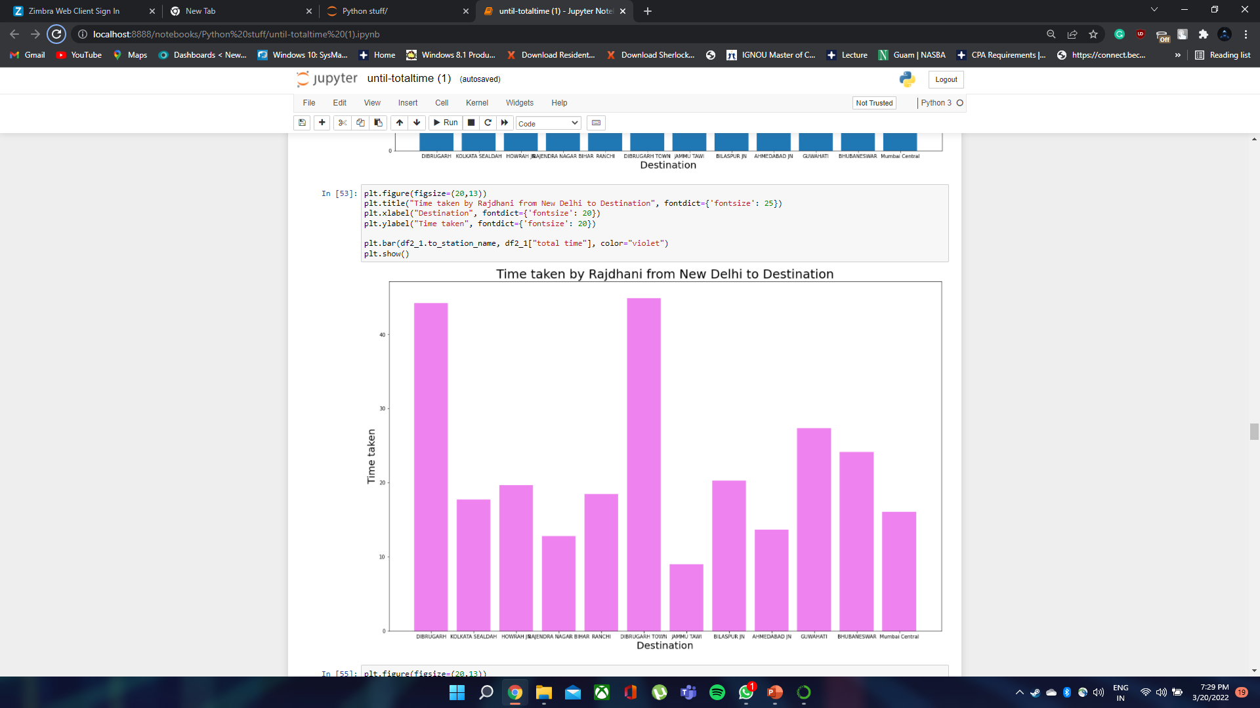

Slide 40
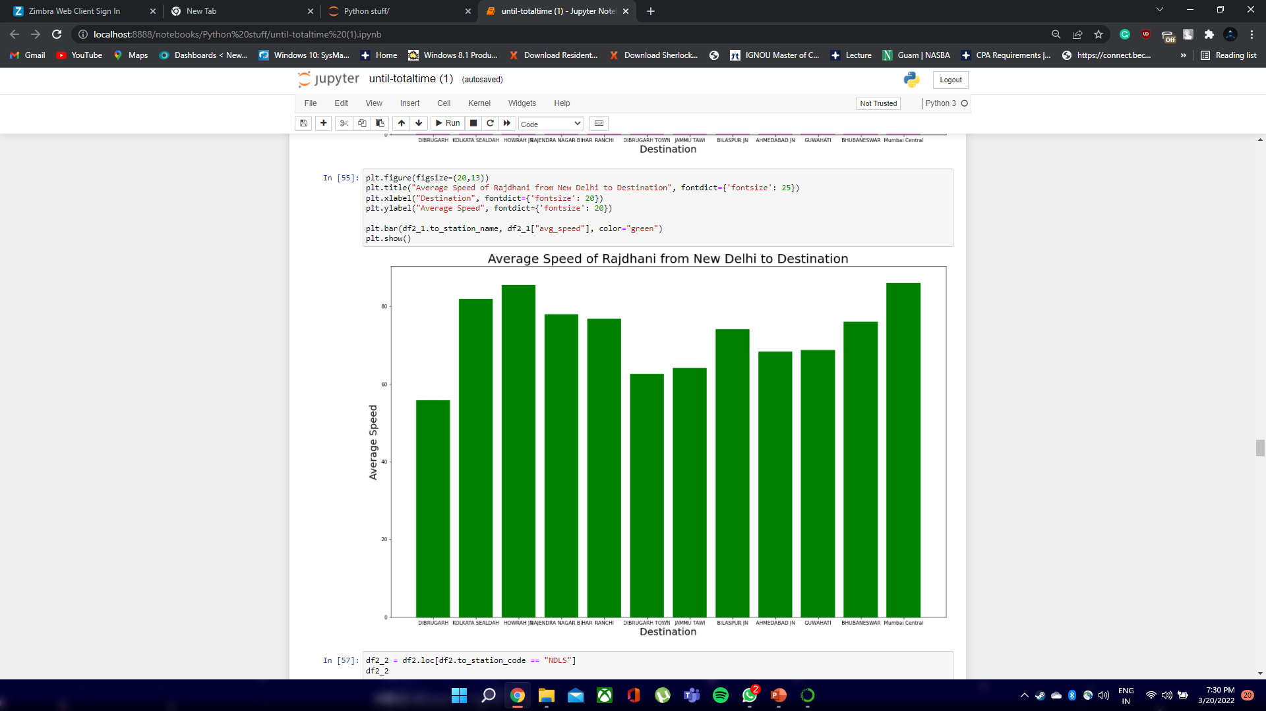

Slide 41
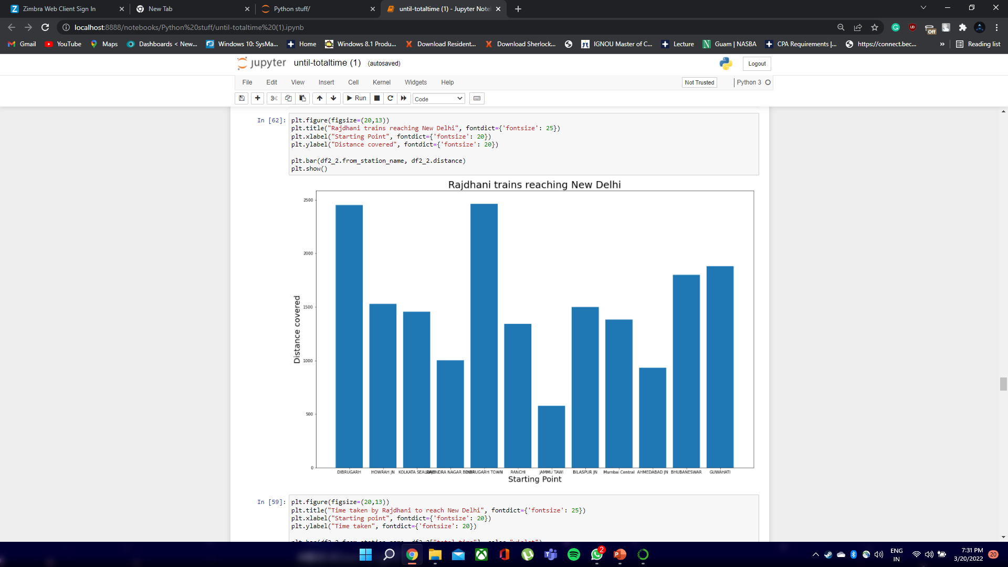

Slide 42
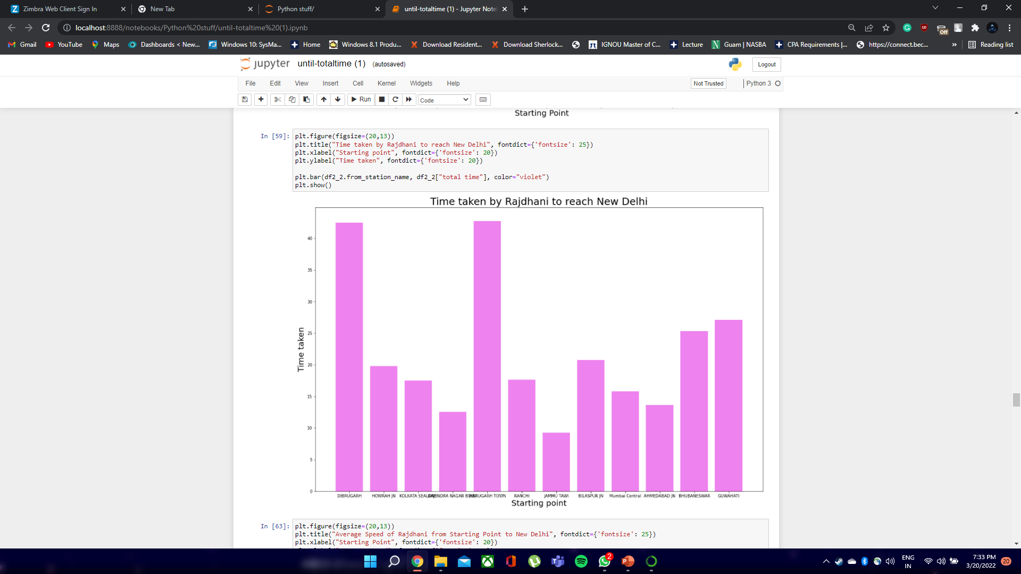

Slide 43
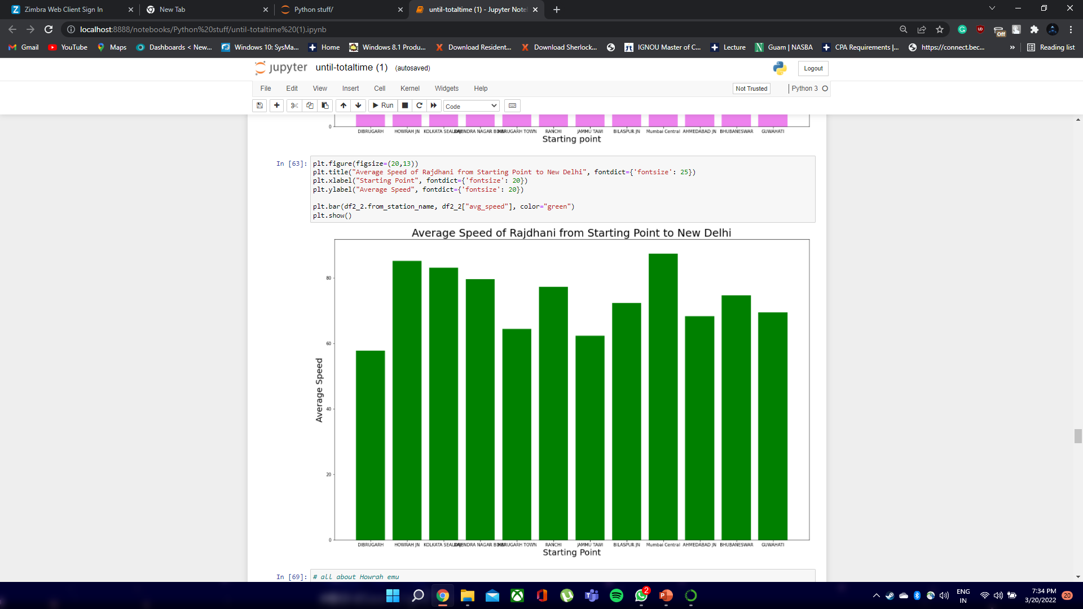

Slide 44
DATA STATISTICS

Slide 45
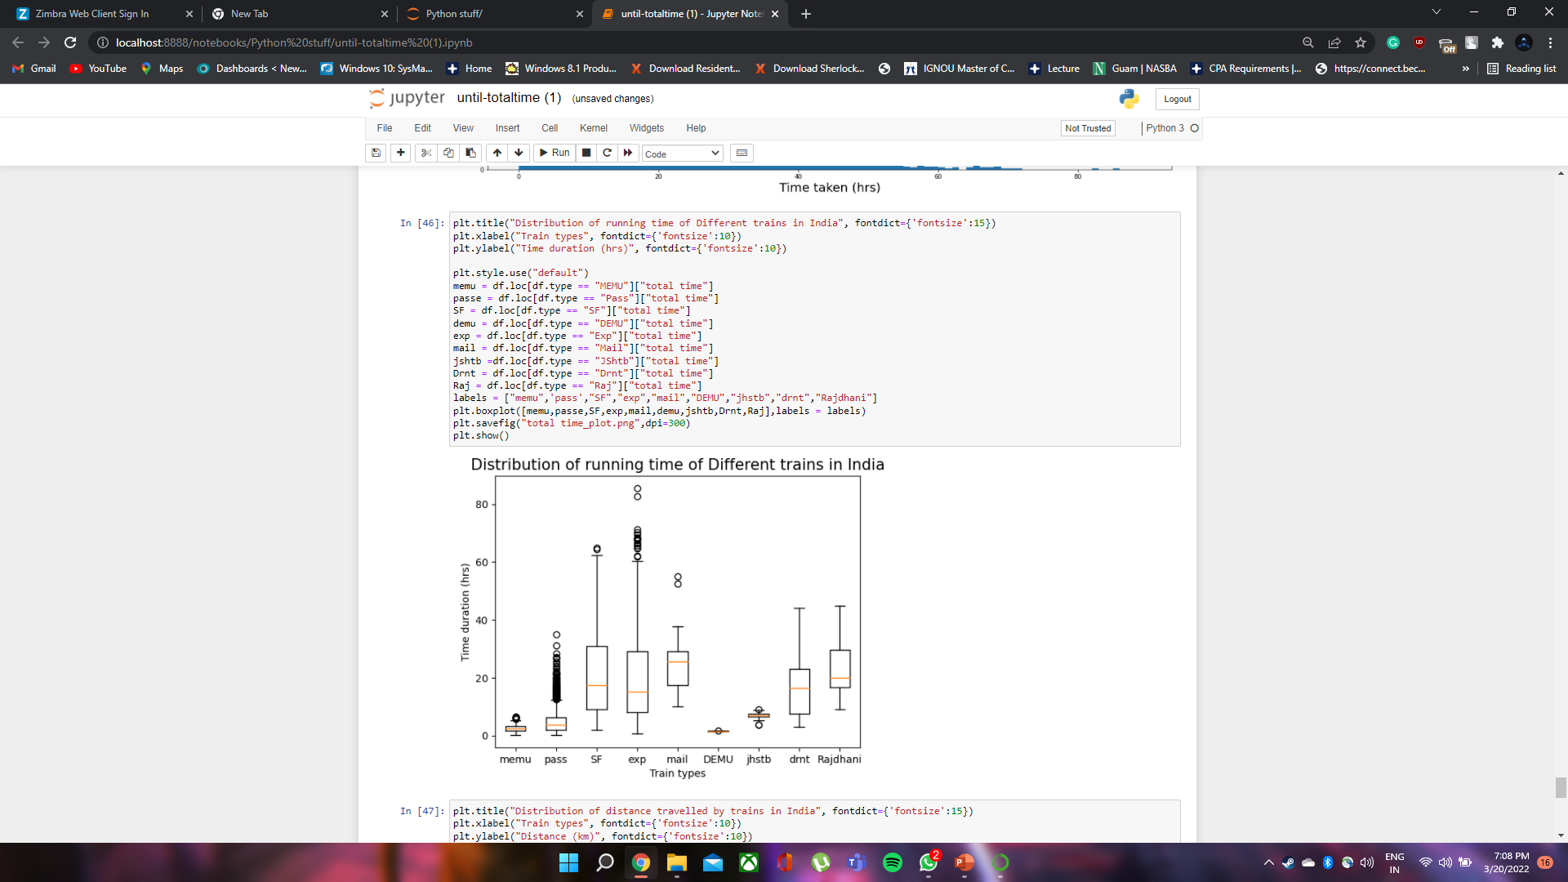
Comparison of time duration of different types of trains

Slide 46
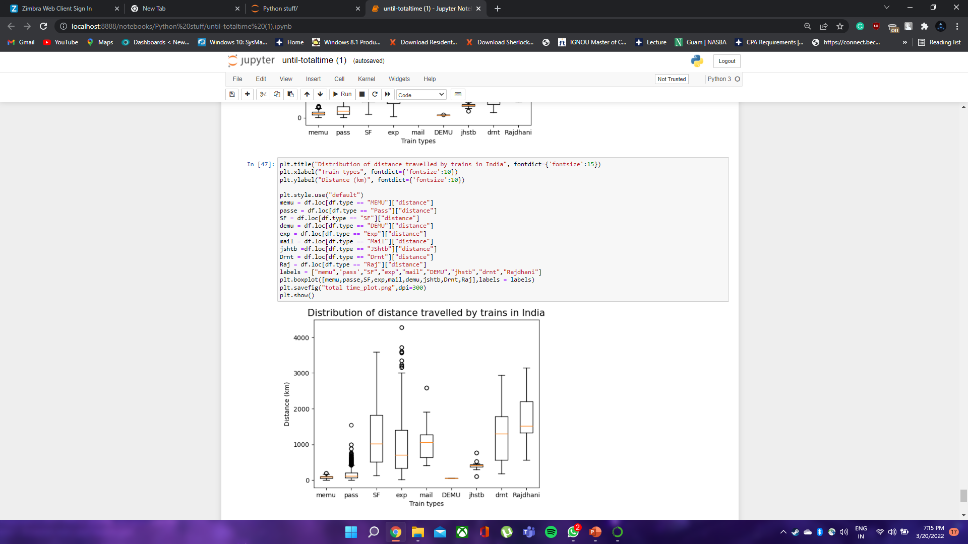
Comparison of distance travelled by different types of trains

Slide 47
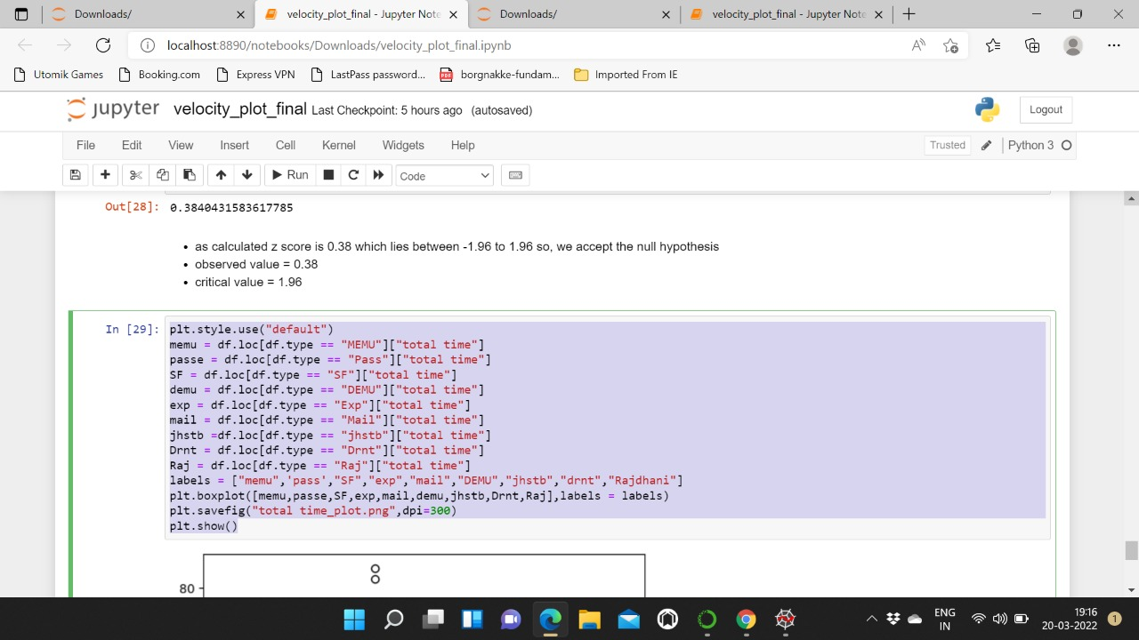
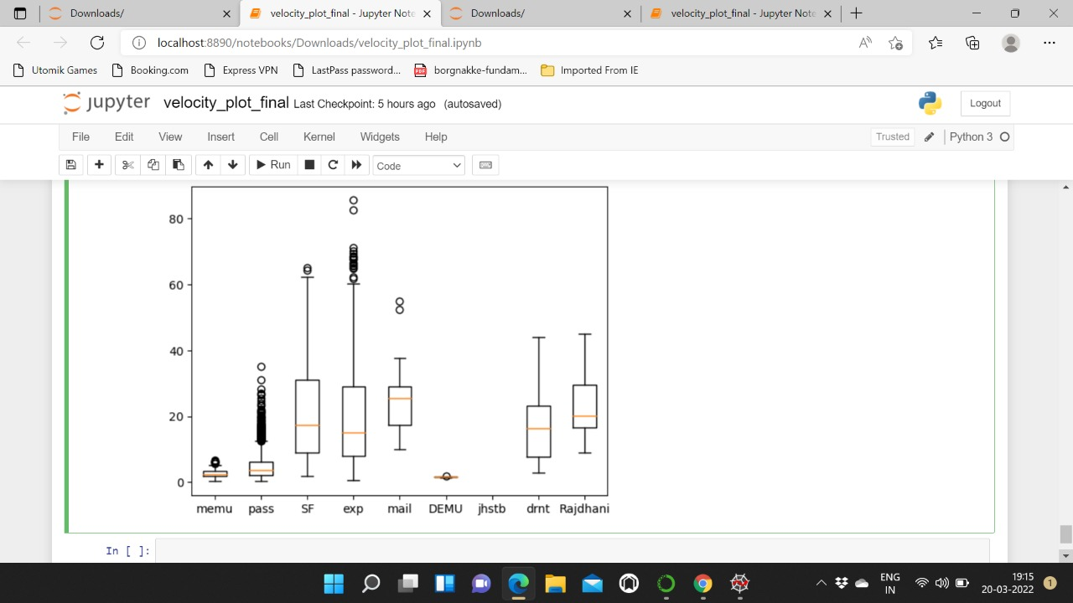
Comparison of average speed of different types of trains.
AVERAGE SPEED

Slide 48
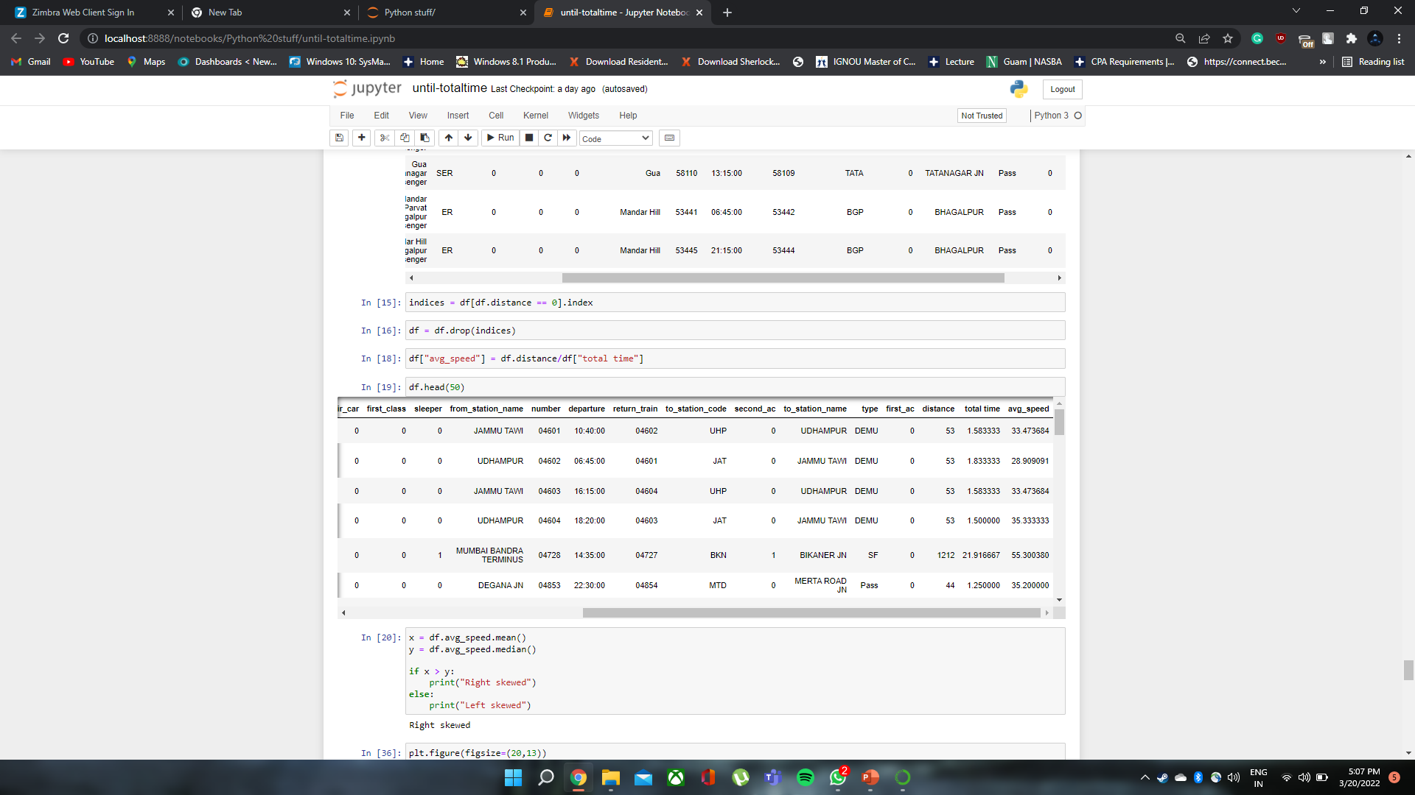
Distribution of average speed of trains
Finding the Average speed by dividing distance by total time

Slide 49
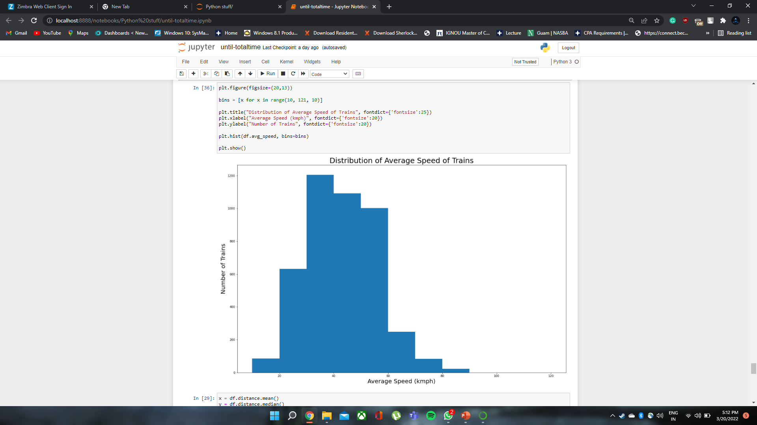
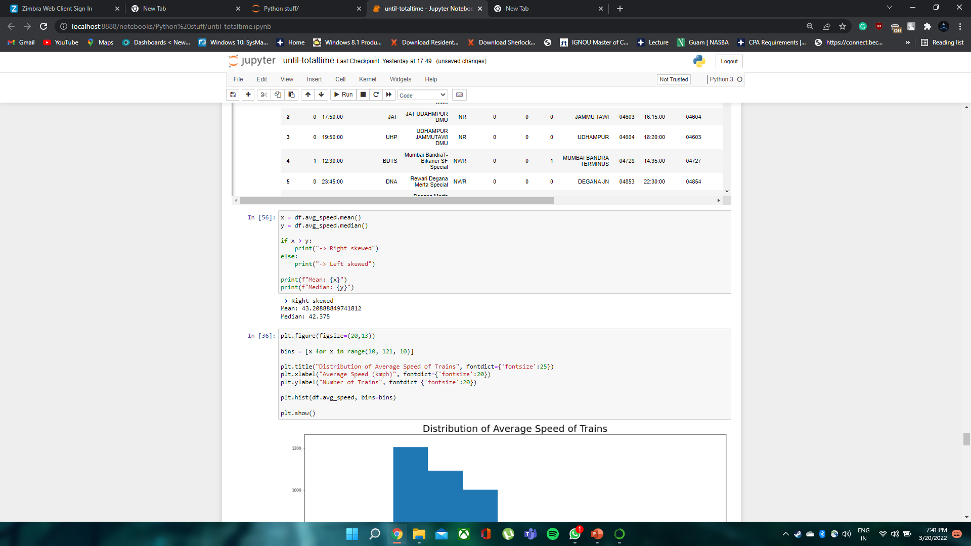
Interesting Fact –
Fastest train - The New Delhi-Bhopal Shatabdi Express having top speed 150 kmph.
Slowest train – The Nilgiri Express having average speed of 10 kmph.

Slide 50


Distribution of Distance travelled by Trains

Slide 51


Distribution of Time taken by trains

Slide 52
Hypothesis testing

Slide 53

The Hypothesis of this data is that the average speed of MEMU trains is 40 kmph.

Slide 54

The Hypothesis of this data is that the average speed of Rajdhani trains is 80 kmph.

Slide 55

The Hypothesis of this data is that the average speed of Passenger trains is 36 kmph.

Slide 56


Shapiro wilk test is used to identify whether the distribution for the dataset is normal or not.
Since p-value is close to 0 we are rejecting the null hypothesis and accepting the alternate one.

Slide 57


WE ARE GROUP - 20
TEAM –
ADITYA BABERWAL 2001ME07
BHAVESH BHOUTMANGE 2001ME14
KRISHNA RAJ 2001ME35
MANAV AGARWAL 2001ME38
PARVESH KUMAR 2001ME44
ROSHAN KISHORE 2001ME62

